Slide 1
AIR POLLUTION
EXPOSURE ASSESSMENT
（空气污染暴露评估）
UCLA Air Quality Management Training Program
Yifang Zhu, PhD
Associate Professor
Phone: (310) 825-4324
E-mail: yifang@ucla.edu

Slide 2
Topics
Basic Concepts in Exposure Assessment
Time-Activity Pattern
Indoor and In-cabin Micro-environment

Slide 3
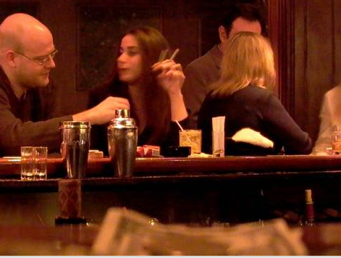
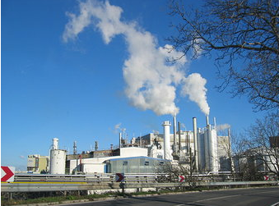
谁的颗粒物暴露水平更高？
A 酒吧里的这位男士
B 住在这个工厂附近的居民

Slide 4
Defining Exposure
Exposure is defined as contact over TIME （时间）and SPACE （空间）
between a person and one or more biological, chemical or physical
agents （媒介，作用物） (US NRC, 1991a).
Exposure assessment is to identify and define the exposures
that occur, or are anticipated to occur, in human populations
(IPCS, 1993).

Slide 5
Some Terminologies used in Exposure Assessment
Agent (s) | biological, chemical, physical, single agent, multiple agents, mixtures
Source (s) | anthropogenic/non-anthropogenic, area/point, stationary/mobile, indoor/outdoor
Transport/carrier medium | air, water, soil, dust, food, product/item
Exposure pathways | eating contaminated food, breathing contaminated workplace air touching residential surface
Exposure concentration | mg/kg (food), mg/liter (water), µg/m³ (air), µg/cm² (contaminated surface), % by weight, fibres/m³ (air)
Exposure route (s) | inhalation, dermal contact, ingestion, multiple routes
Exposure duration | seconds, minutes, hours, days, weeks, months, years, lifetime
Exposure frequency | continuous, intermittent, cyclic, random, rare
Exposure setting (s) | occupational/non-occupational, residential/non-residential, indoors/outdoors
Exposure population | general population, population subgroups, individuals
Geographic scope | site/source specific, local, regional, national, international, global
Time frame | past, present, future, trends

Slide 6
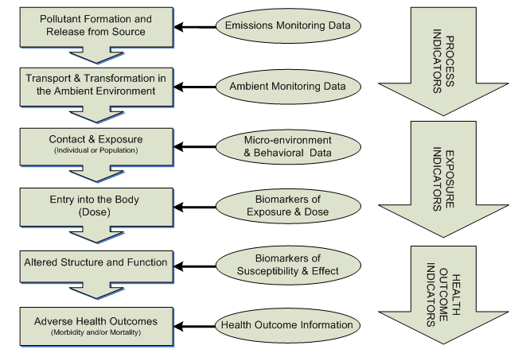
Defining Exposure
排放
监测
微环境+行为
暴露水平生物标记
敏感度生物标记
健康结果
Environmental and Public Health Continuum (EPA 2006)
Notes:
Exposure indicators3 measure or estimate the direct contact of humans with chemicals in their environment (see Figure 1). These indicators are quantified using ambient pollutant measurements, stochastic models of exposure (models that consider people’s activities and locations), personal monitoring data, and biological monitoring data (identifying amounts of pollutants and/or their metabolites in the body). Exposure indicators are usually related to health outcomes using information on the toxicity of a pollutant or epidemiological data that relate exposure to adverse health outcome(s).

Slide 7
Defining Exposure
Data Collection
●Diaries ● Questionnaire ● Emission ● Environmental ● Personal ● Human tissue
Inventories monitoring monitoring monitoring
Predictive Models
Physical, statistical, and physical-statistic models
●Fate and transport ● Human activity ● Human exposure ● Pharmacokinetic
models pattern models models models
Exposure and dose estimates
●Population ● Subpopulations ● Individuals
The relationship among data collection, predictive models, and exposure and dose estimates (Sexton et al., 1995b)

Slide 8
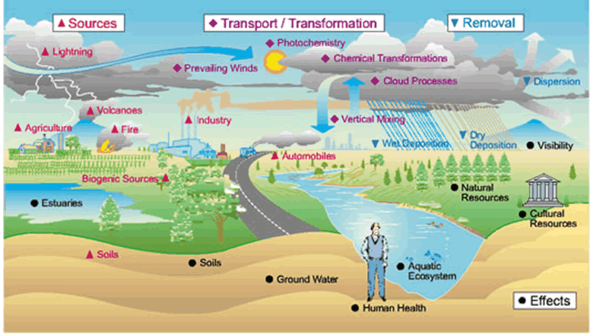
Key Events in Exposure Assessment
Source: The point or area of origin for an environmental agent is known as a source.
Identify potential sources in this graph. Are they primary （一次污染）
or Secondary （二次污染）?
Anthropogenic （人工排放）or Non-anthropogenic （自然产生）?
Notes:
Agents are released into the environment from a wide variety of sources, which are often categorized as primary sources including point sources (e.g., incinerator) versus area sources (e.g., urban runoff), stationary sources
(e.g., refinery) versus mobile sources (e.g., automobile) and anthropogenic sources (e.g., landfill) versus non-anthropogenic sources (e.g., natural vegetation) and secondary sources including condensation of vapors into particles and chemical reactions of precursors producing new pollutants.

Slide 9
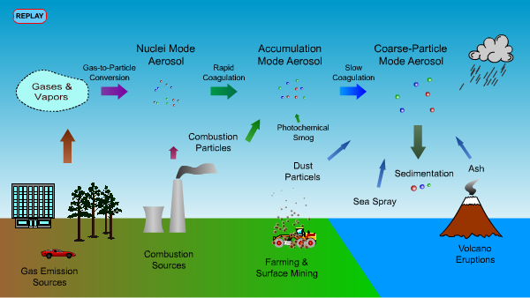
Dynamic Processes of Atmospheric Aerosol
http://www.aerosols.wustl.edu/education/atmos_aerosol/section05.html

Slide 10
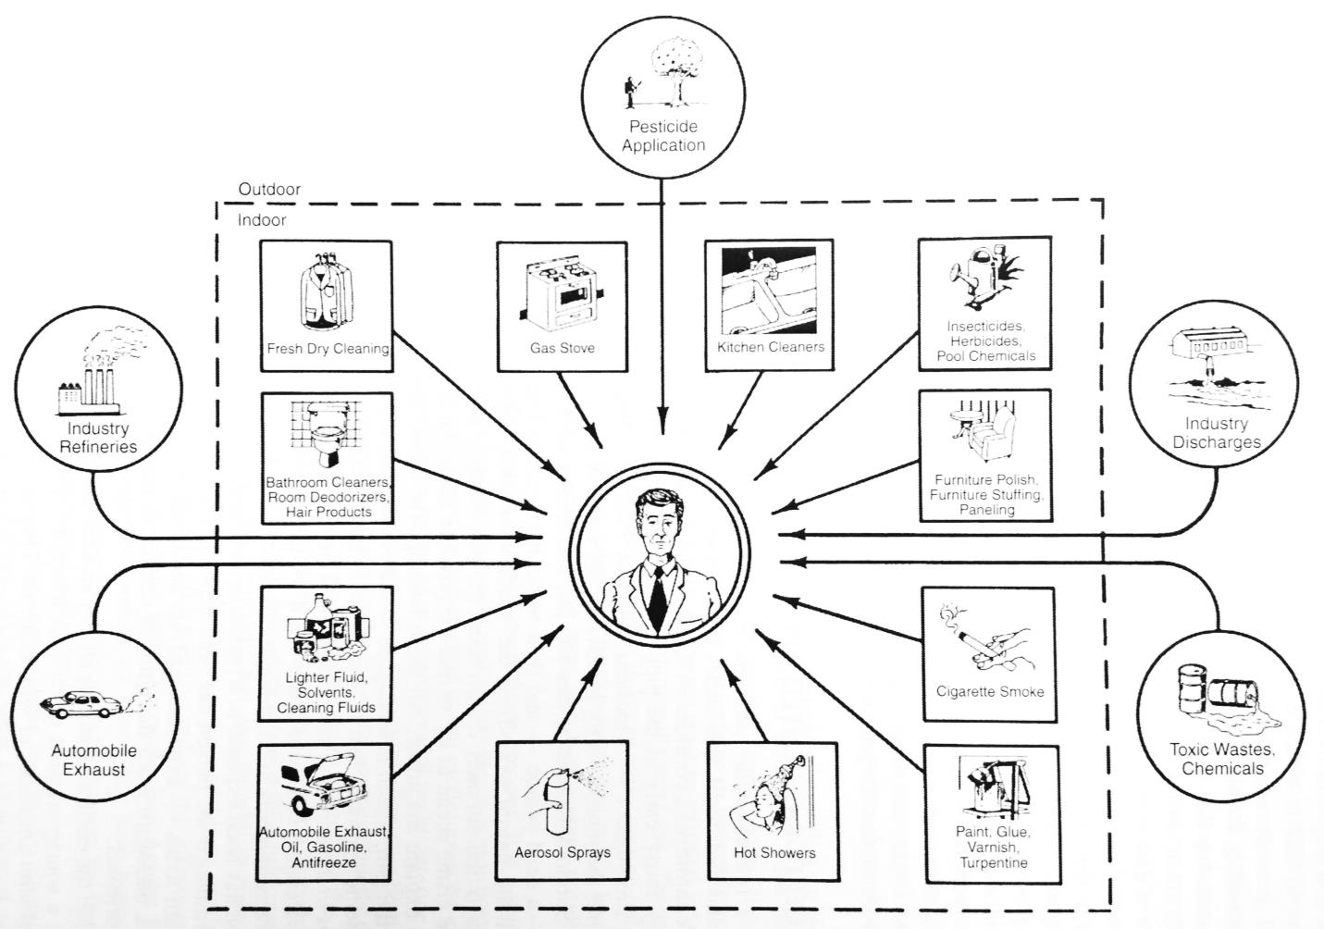
Examples of traditional and non-traditional sources of exposure

Slide 11
Key Events in Exposure Assessment
Exposure path way: An exposure pathway is the physical course taken by an
agent as it moves from a source to a point of contact with a person.
The substance present in the media is quantified as its concentration.
Exposure concentration: The concentration of an environmental
agent in the carrier medium at the point of contact with the body.
(mg/liter, mg/kg, μg/m³). The concentration is the amount (mass) of
a substance or contaminant that is present in a medium such as air, water,
food or soil expressed per volume or mass.
Exposure Route: Exposure route denotes the different ways the substance
may enter the body. The route may be dermal, ingestion or inhalation.
Notes:
Assessments are often not at exposure or exposure concentration, since that information alone is not very useful unless it is converted to dose or risk. Assessments therefore usually estimate how much of an agent is expected to enter the body. This transfer of an environmental agent from the exterior to the interior of the body can occur by either or both of two basic processes: intake and uptake.

Slide 12
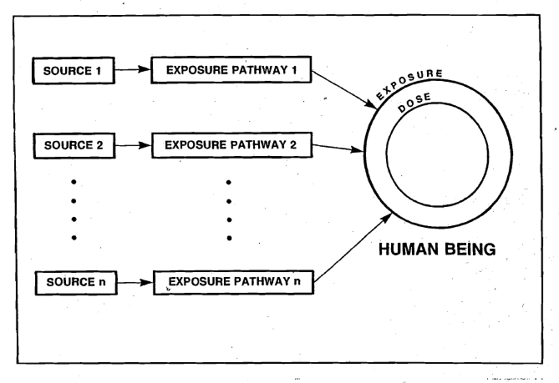
Movement of the pollutant from the source to the target (a human being) is shown as an "exposure pathway" for each source. The entire journey of a pollutant from a source to a target is a "route of exposure."

Slide 13
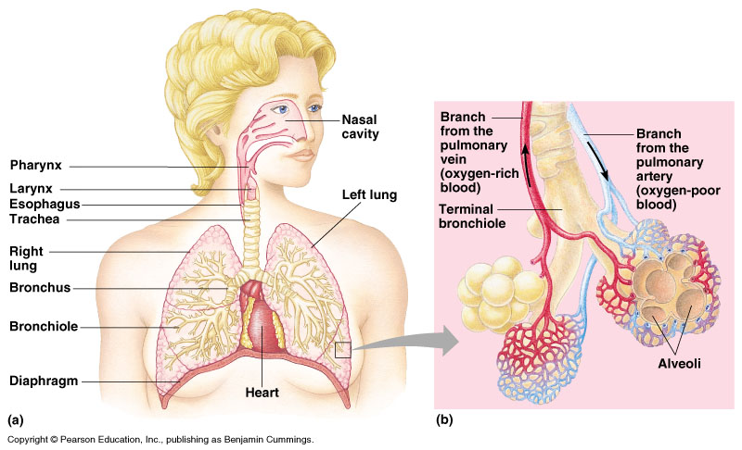
Pathways of Particle Translocation Within and Outside Respiratory Tract
Translocation of UFP from
NP and TB region along sensory
neurons to CNS (neurodegeneration)
Translocation of UFP to
interstitium, capillaries, heart
Uptake by endothelium; platelets
Activation/interaction of endothelial
cells, platelets and leukocytes
Alveolar inflammation

Slide 14
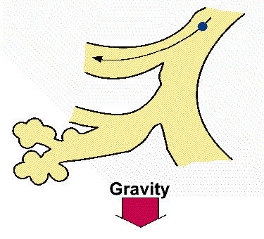
Uptake of Particulate Pollutants: Impaction
Airflow changes due to a bifurcation in the airways.
Particles tend to travel along their original path due to inertia.
Highly dependent on aerodynamic diameter: Dp Stopping distance
Impaction
Deposition by impaction is greatest in the bronchial region.
Impaction accounts for the majority of particle deposition on a mass basis.
(Source: http://www.mfg.mtu.edu)

Slide 15
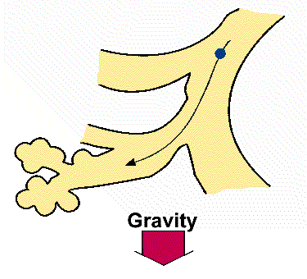
Uptake of Particulate Pollutants: Sedimentation
Sedimentation is the settling out of particles in the smaller airways of the bronchioles and alveoli.
Air flow is low and airway dimensions are small.
Dependent on the terminal settling velocity of the particles: Dp
Settling velocity
Hygroscopic particles may grow in size as they pass through the warm, humid air passages, thus increasing the probability of deposition by sedimentation.
(Source: http://www.mfg.mtu.edu)

Slide 16
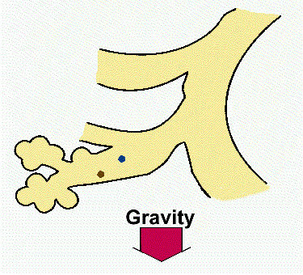
Uptake of Particulate Pollutants: Diffusion
Diffusion is the primary mechanism of deposition for particles < 0.5 μm in diameter.
Governed by geometric rather than aerodynamic size. Dp Diffusion
Diffusion is the net transport of particles from high concentration region to a lower concentration region due to Brownian motion.
Occurs mostly when the particles have just entered the head airway, and is also most likely to occur in the smaller airways of the alveolar region, where air flow is low.
(Source: http://www.mfg.mtu.edu)

Slide 17
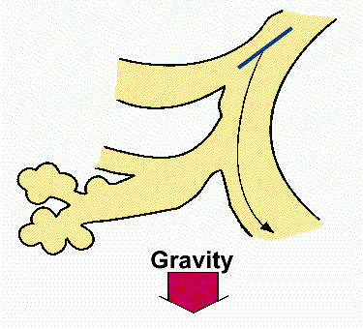
Uptake of Particulate Pollutants: Interception
When a particle contacts an airway surface due to its physical size or shape.
Particles do not deviate from their air streamlines.
Interception is most likely to occur in small airways or when the air streamline is close to an airway wall.
Interception is most significant for fibers. Fibers have small aerodynamic diameters relative to their size, so they can often reach the smallest airways.
(Source: http://www.mfg.mtu.edu)

Slide 18
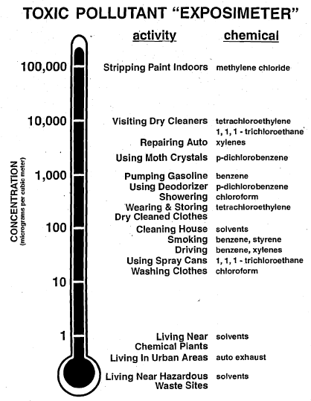
Toxic pollutant “exposimeter" proposed by Wallace (1998) as a public information tool for communicating about human exposure to VOCs provides a single logarithmic scale for comparing the exposure levels associated with personal activities and the levels associated with traditional
outdoor sources.

Slide 19
Key Events in Exposure Assessment
Dose: Once the agent enters the body by either intake or uptake, it is described as a dose.
Several different types of dose are relevant to exposure estimation.
    Potential dose: the amount of the agent that is actually ingested, inhaled or
    applied to the skin.
    Applied dose: the amount of the agent directly in contact with the body's
    absorption barriers, such as the skin, respiratory tract and gastrointestinal
    tract, and therefore available for absorption.
    Internal (absorbed) dose: The amount of the agent absorbed, and therefore
    available to undergo metabolism, transport, storage or elimination.
    Delivered dose: the portion of the internal (absorbed) dose that reaches a tissue
    of interest.
    Biologically effective (target) dose: the portion of the delivered dose that
    reaches the site or sites of toxic action.
The link, if any, between biologically effective (target) dose and subsequent
disease or illness depends on the relationship between dose and response
(e.g., shape of the dose-response curve), underlying pharmacodynamic mechanisms
(e.g., compensation, damage, repair), and important susceptibility factors
(e.g., health status, nutrition, stress, genetic predisposition).

Slide 20
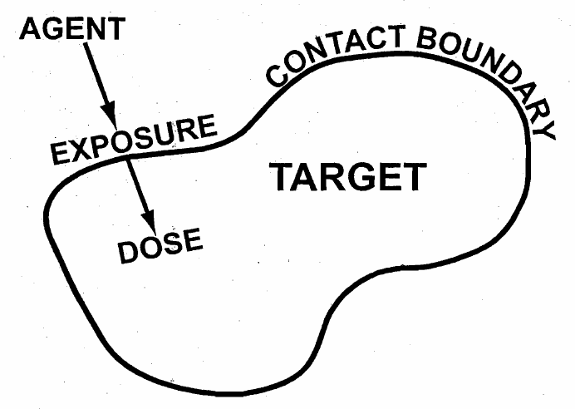
Schematic illustrating the difference between exposure and dose.
Notes:
Because the terms “exposure” and “dose” are closely linked, we use the general definition of dose as the amount of agent that enters a target in a specified time duration after crossing a contact boundary. While there can be exposure without a corresponding dose, there can be no dose without a corresponding exposure. For example, if the skin surface is specified as the contact boundary, exposure of the skin occurs if chemical is placed on the skin surface. If the chemical does not partition into the stratum corneum, then there is no does.

Slide 21
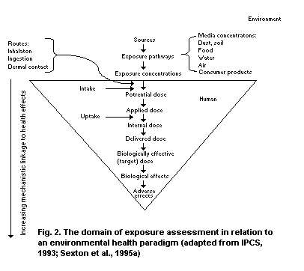
Defining Exposure

Slide 22
Elements of Exposure Assessment
Exposure:
  routes, pathways and frequencies
  duration of interest (short-term, long-term, intermittent or peak exposures)
  distribution (e.g., mean, variance, 90th percentile)-- population, important
  subpopulations (e.g., more exposed, more susceptible)
  individuals -- average, upper tail of distribution, most exposed in population.
Dose:
- link with exposures
- distribution (e.g., mean, variance, 90th percentile) -- population important
subpopulations (e.g., higher doses, more susceptible)
- individuals -- average, upper tail of distribution, highest dose in population.
Causes:
- relative contribution of important sources
- relative contribution of important environmental media
- contribution of important exposure pathways
- relative contribution of important routes of exposure.

Slide 23
Elements of Exposure Assessment
Variability:
  within individuals (e.g., changes in exposure from day to day for the same
  person)
  between individuals (e.g., differences in exposure on the same day for two
  different people)
  between groups (e.g., different socio-economic classes or residential
  locations)
  over time (e.g., changes in exposure from one season to another)
  across space (e.g., changes in exposure/dose from one region of a city,
  country to another).
Uncertainty:
- lack of data (e.g., statistical error in measurements, model parameters, etc.;
misidentification of hazards and causal pathways)
- lack of understanding (e.g., mistakes in functional form of models, misuses
of proxy data from analogous contexts).

Slide 24


Example of misuses of proxy data from analogous contexts :
Total Particle Number Concentration near Freeways
Nighttime Dominant Wind
Daily exposure to Ultrafine Particles:
3 folds of difference between the two cases
Notes:
This is the spatial profile for total particle number concentration measured by the CPC during our previous daytime study.
This is the dominant day time wind direction relative to the freeway. Downwind of the freeway during daytime, we observed a sharp exponential decay of total particle number concentrations. This is the dominant nighttime wind direction relative to the freeway. The daytime downwind side of the 405 freeway becomes the upwind side and the daytime upwind side becomes the downwind side at night. Downwind of the freeway at night, similar exponential decay of total particle number concentrations was observed but at a slower rate compare to day time. This is mainly due to the lower wind speed and less atmospheric dispersion and dilution effect at night. In contrast to what happened during daytime, where particle number concentrations at 300 m downwind of the freeway was comparable to what was measured at 300 m upwind of the freeway, nighttime downwind particle number concentrations at 500 m were still significantly greater than those measured at the upwind site. This implies that freeway emissions have a much broader effect on local air quality at night. Many epidemiology studies that focused on traffic related health effects have relied on distance from major roads as a proxy for exposures. It is clear in this figure, distance by itself is not a good measure of exposure to traffic exhaust. Pollutant levels near roadways depend strongly on the direction of the wind and other meteorological parameters. Thus, diurnal and seasonal variations in meteorology have to be taken into consideration to accurately estimate near roadway exposures. In addition, please noted, the measured particle number concentration at 30 m downwind of the freeway at night was about 80% of the daytime value, but the traffic volume on the 405 freeway at night was only about 25% of the daytime traffic density. Lower wind speed and weaker atmospheric dilution alone could not explain this observed discrepancy because carbon monoxide (CO) concentrations at 30 m downwind of the freeway at night (0.5 ppm) was about 25% of what we observed during the daytime (2.0 ppm). This suggest a higher emission factor in terms of particle number concentration per vehicle occurs at night.

Slide 25
Quantitative Exposure Assessment
Direct Assessment: including point-of-contact measurements and biological
indicators of exposure. Direct approaches for air, water and food
include personal air monitors, measurements of water at the point
of use and measurement of the food being consumed.
Indirect Assessment: including environmental monitoring, modeling,
questionnaires (US NRC, 1991b). Indirect approaches include
microenvironmental air monitoring and measurements of the water
supply and food supply (contents of a typical food basket, for instance).
Exposure models are constructed to assess or predict personal
exposures or population exposure distributions from indirect
measurements and other relevant information.
Biomarkers provide a direct measure of exposure modified by and
integrated over some time in the past which depends on physiological
factors that control metabolism and excretion.

Slide 26
Basic Information Needed for Exposure Assessments in Different Contexts
Contexts | Information Required
Risk Assessment | Point estimates or distributions of exposure and dose. Duration of exposure and dose.
Risk Management (conducted once hazard is identified) | Pollutant source contributing to exposure and dose personal activities contributing to exposure and does. Effectiveness of intervention measures
Status and trend | Change of exposure and dose of populations over time.
Epidemiology | Individual and population exposures and doses, exposure dose categories.

Slide 27
Defining Exposure
Hazard identification
(Does the agent cause
the adverse effect?)
RISK ASSESSMENT
Dose-response assessment
(What is the relationship
Between dose and incidence
In humans?)
Risk characterization
(What is the estimated
Incidence of the adverse
effect in a given population?)
RISK
MANAGEMENT
Exposure assessment
(What exposure are currently
Experienced or anticipated
Under different conditions?)
Elements of risk assessment (modified from US NRC, 1983)

Slide 28
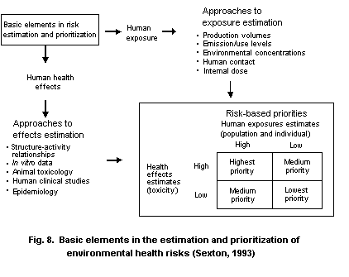

Slide 29
如果你需要找到某个人
什么时间，去哪里，
最有可能找到他？

Slide 30
Human Time-Use Patterns
In an exposure context, data about human time use and activity patterns (often referred to as time-activity data) have four related purposes.
Knowledge of the activities performed while a study participant carried a personal monitor can aid in identifying the determinants of exposure, i.e., "What did this person do that led her/him to have such a high exposure?" and "To what extent can exposure be explained the amount of time spent in specific activities or locations?"
Time-activity data allow modeling of human exposure to pollutants for which personal monitors are not yet available or are very expensive, or for which exposure is a function of multiple pathways.
Notes:
For instance, several studies in which activity pattern data were collected in conjunction with monitoring data have shown that indicators such as commuter status, work status, cooking fuel type, season, residential location and day of week are important in differentiating exposure to carbon monoxide and nitrogen dioxide (Akland et al., 1985; Ryan et al., 1990; Schwab et al., 1990; Berglund et al., 1994a). Investigations of VOC exposure have found that people who reported engaging in auto-related activities (e.g., exposure to vehicle exhausts, pumping gasoline and visiting a service station) were associated with statistically significant increases in breath and personal exposure levels of several aromatic and aliphatic compounds; reporting a smoker present in the home was associated with increased indoor concentrations and personal exposures of aromatic compounds; visiting dry cleaners, self-reports of proximity to smokers, pesticide use, exposure to solvent, degreasing compounds, and odorous chemicals, and employment status in certain occupations (e.g., paint, chemical or plastics plants) were associated with increased personal exposure to several VOCs (Wallace et al., 1985, 1986, 1988). Occupational exposure may be an important component of total exposure for some individuals or sub-populations.
Total exposure can be simulated from information on the time spent doing various activities and/or in specific locations, coupled with knowledge about the likely range of pollutant concentrations in each situation. For example, the models SHAPE (Ott et al., 1988), NEM (Johnson et al., 1990), SIMSYS (Sexton & Ryan, 1988), and REHEX (Hall et al., 1992) are currently being used to estimate exposure to carbon monoxide, ozone, particulates, sulfur dioxide and nitrogen dioxide. Techniques are also being developed to allow prediction of dermal and ingestion exposures based on assumptions about human activity patterns (e.g., Fenske, 1993). The usefulness of all of these models is dependent upon the accurate characterization of pollutant-relevant time-activity patterns.

Slide 31
Human Time-Use Patterns
From an epidemiological perspective, activity patterns can be used to assess the relationship between exposure and health status (e.g., Armstrong, 1985). In epidemiology, time-activity data may serve four purposes:
  They may be a surrogate of the exposure of interest.
  They may be used to improve another imperfect measure of exposure.
  They may be used as a surrogate for a cofactor which might confound the association between health and some other exposure.
  The association of an exposure with some health outcome might not be the same in subgroups of different time-activity patterns (modified effect).
Another purpose of time-activity data is to describe patterns of population behavior.
Notes:
For instance, "Do those who engage in potentially high-exposure activities experience more frequent or severe illnesses?" or "Do sensitive individuals avoid potentially high-exposure activities or limit them to certain times of day or locations?"
For example, people may be asked about the hours they spend indoors with smokers to assess health effects of environmental tobacco smoke (Leuenberger et al., 1994).
For example, estimates of long-term exposure to ozone may be derived from fixed site monitor data, weighted, however, for duration of time spent in outdoor activities (Künzli et al., 1997a,b).
For example, the effect of ambient air pollution on lung function may be thought to be confounded by environmental tobacco smoke exposure (ETS). Time spent with smokers could thus be used to control this potential confounding.
In this case, time-activity data will allow the investigator to address such interactions
The proportion of time spent by the population in various microenvironments or frequency of use of various facilities (e.g., swimming pools) may provide an indication for the contribution of each of the microenvironments or activities on total population exposure. In such studies, the emphasis is on characteristics of groups, and not on individual data. Therefore the precision of the estimates may be improved by the increased sample size although the survey tools may remain relatively simple and inexpensive.

Slide 32
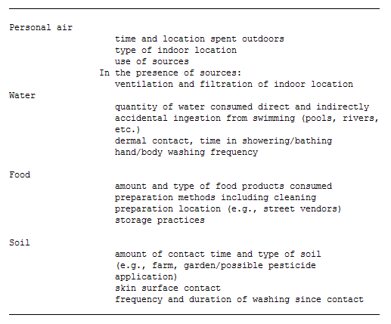
Human Time-Use Patterns
Type of information obtained from time-activity data relevant to specific exposure pathways

Slide 33
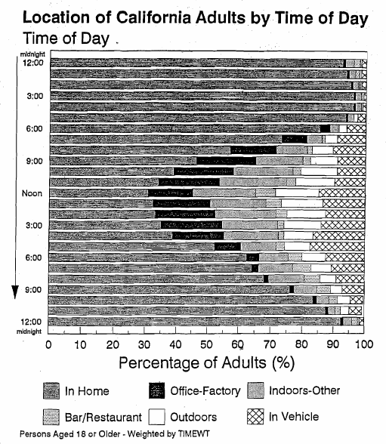
Proportion of the California adult population present in each of six locations by time of day, based on a computer analysis of the diaries from a stratified representative random sample of 1579 persons aged 18 or older throughout the State.
Ott et al., (1993)

Slide 34
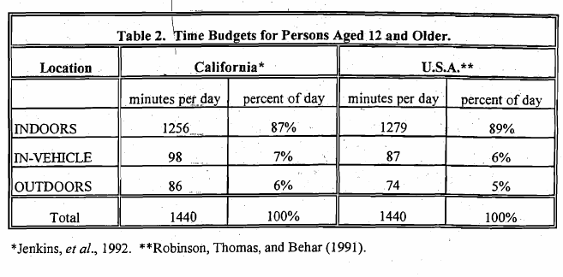
Time spend outdoors accounts for the smallest amount of total time even smaller than the average time spent in a motor vehicle. Despite the widely held view that Californians are outdoors much more than people living elsewhere in the U.S., the differences between California and the U.S. are extremely small (Robinson et al., 1991).

Slide 35
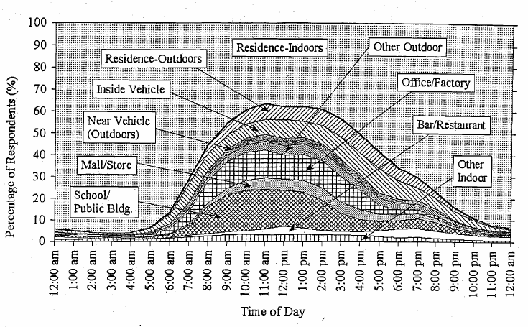
When people were outdoors, they were most likely to be outdoors at their residence while the most likely location for finding anyone was indoors at their residence.

Slide 36
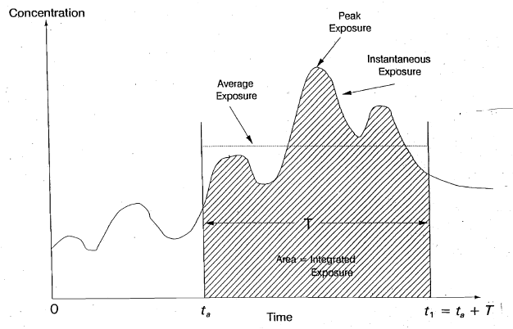
Hypothetical exposure time profile: Pollutant exposure as a function of time showing how the average exposure, integrated exposure, and peak exposure relate to the instantaneous exposure. (Source: Duan er al., 1989, 1990)

Slide 37
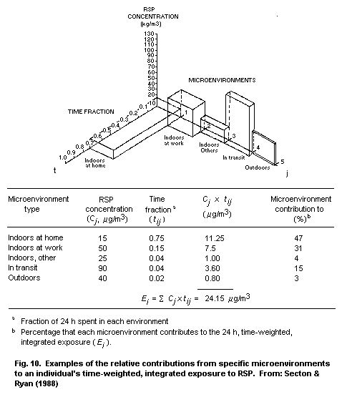
如果已知某个微环境中的可吸入颗粒物浓度，以及个体在其中所停留的时间，就可以估算个体的总体暴露水平，并且比较各个不同的微环境对总暴露水平的贡献。

Slide 38
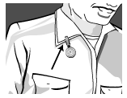
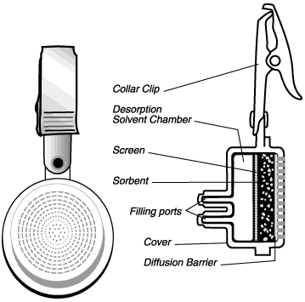
Exposure Assessment Approaches
Personal monitoring of inhalation exposures
Passive Samplers for gas-phase pollutants (CO, NOx, VOC, Ozone, etc)
Like small "badges" that collect organic vapors or other gas-phase pollutants without the use of a pump. Individual chemicals simply diffuse from the atmosphere into the sampler at a fixed rate.
*Courtesy SKC, Inc.

Slide 39
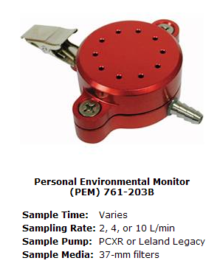
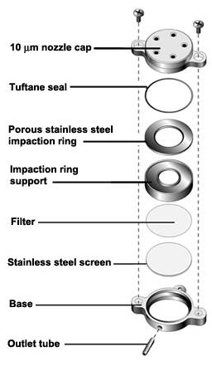
Exposure Assessment Approaches
Personal monitoring of inhalation exposures
Personal Environmental Monitor (PEM)
The PEM consists of three major parts: cap, impaction ring assembly, and base.
The cap contains the round nozzles where the air will enter the sampler.
The impaction ring assembly serves as an impaction surface and as a clamping ring for the final filter.
The base supports the final filter.
*Courtesy SKC, Inc.

Slide 40
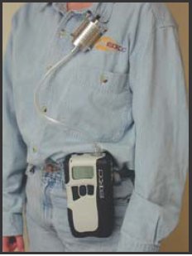
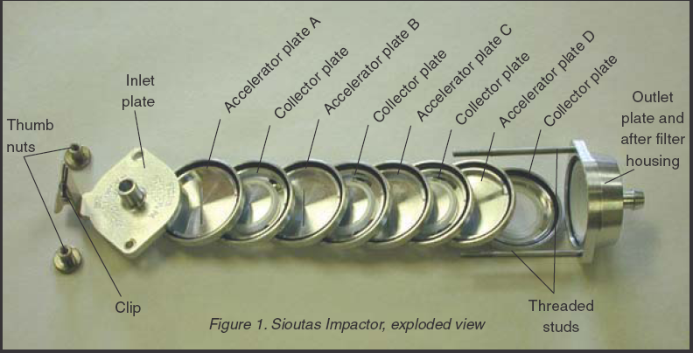
Exposure Assessment Approaches
Personal monitoring of inhalation exposures
Sioutas Cascade Impactor: sample coarse, fine and ultrafine particles
*Courtesy SKC, Inc.

Slide 41
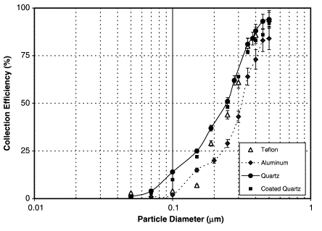
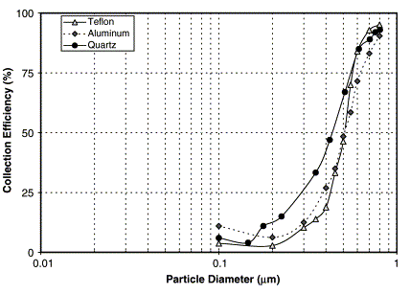
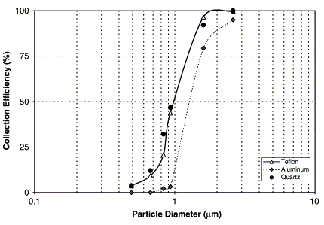
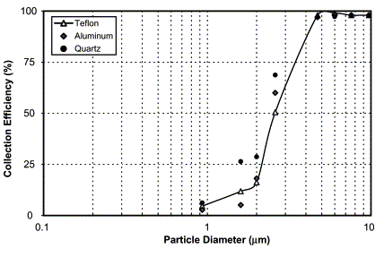
Exposure Assessment Approaches
Sioutas Cascade Impactor Collection Efficiency Curves (Misra et al., 2002)
0.25 μm
stage
0.5 μm
stage
1.0 μm
stage
2.5 μm
stage

Slide 42
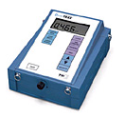
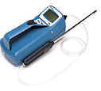
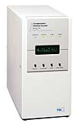
Exposure Assessment Approaches
Personal monitoring of inhalation exposures
Real-time particle counters.
TSI DustTrak: A laser photometer provides real-time PM10 or PM2.5 mass concentrations.
TSI P-Trak: Use isopropyl alcohol as condensing fluid to detect particles down to ~20 nm.
TSI Water CPC 3785: Use water as condensing fluid to detect particles down to ~ 5 nm.
*Courtesy TSI, Inc.

Slide 43
Exposure to Indoor Pollutants
A sub-set of total exposure in various micro-environments in which we spend time
The indoor microenvironment is highly important because we spend nearly 90% of our time there
A range of factors affect indoor air quality and people exposures there

Slide 44
Factors Affecting Indoor Air Quality
Indoor sources (e.g. for Particulate Matter, CO, VOCs)
Penetration of outdoor air
Air exchange rate (ventilation rate)
Human activity (personal cloud)

Slide 45
The Toxic House
Pollutant | Health Issues | Remedies
Asbestos | Lung disease, chest and abdominal cancers | Leave undamaged material alone.
CO | Headaches, dizziness, death at high concentrations | Maintain or avoid unvented space heaters
NO2 | Respiratory ailments | Keep kitchen well ventilated
Pesticides | Nervous system, kidney damage, cancer | Don’t store pesticides inside home, ventilate well
Radon | Causes about 10% of lung cancer death in U.S. | Test home, seal basement floor, ventilate crawl space
VOCs | Headaches, kidney damage, dizziness | Use water-based paints, keep home ventilated
Formaldehyde | Skin rash, wheezing, human carcinogen | Avoid pressed wood, choose carpet carefully

Slide 46
Sick Building Syndrome (SBS)
Used to describe a set of symptoms with unidentified etiology frequently reported by office building workers
According to WHO (1983) SBS is characterized by eye, nose and throat irritation; dry mucous membranes; mental fatigue; headache; frequent airway infections; hoarseness; wheezing and itching; nausea and dizziness
SBS symptoms are associated with occupancy in a building and dissipate when the individual is absent from the building.

Slide 47
Indoor Carbon Dioxide (CO2)
Primary source of CO2 indoors is human respiration
Typical concentration range in office building is 370 ppm (outdoor background) to 2,500 ppm
At these concentrations CO2 is not thought to be a direct cause of health effects
However, indoor CO2 can be considered a surrogate for other occupant-generate pollutants, and for ventilation rate per occupant (but not as a causal factor in human health response)

Slide 48
CO2 TLV and Minimum Ventilation Rate
The Threshold Limit Value for 8-hr average exposures to CO2 is 5000 ppm (ACGIH 1991)
ASHRAE (1999) recommends a minimum office building ventilation rate of 10 L/sec per person
This corresponds to an approximate steady state indoor concentration of 870 ppm
Based on the assumptions that outdoor CO2 is 350 ppm and indoor CO2 generation rate is 0.31 L/min per person.
ASHRAE=American Society of Heating, Refrigeration, and Air-conditioning Engineers

Slide 49
Measuring or Estimating Indoor Pollutant Concentration
Sophisticated methods are available for direct measurement of a wide range of indoor air pollutants
Research has documented the ranges of concentrations for key pollutants, especially those with indoor sources
We can also estimate indoor and in-vehicle concentrations, due to intrusion of outdoor pollutants, using measured indoor/outdoor (I/O) ratios
Personal exposure is measured in the breathing space using portable monitors worn 24 hours a day

Slide 50
Typical Indoor/Outdoor Ratios for Ozone and NO2
Ozone is highly reactive on surfaces. Typical indoor levels are about 50% of outdoor levels. (For tight buildings, e.g. some schools, I/O ratio can be as low as 0.2)
Therefore it is protective to move inside during high ozone episodes
Nitrogen dioxide is less reactive than ozone and has indoor sources (e.g. gas ranges, hot water heaters). There fore indoor concentrations may be roughly the same as outdoor concentrations or even higher
Generally use 0.5 and 1.0 for I/O ratios for ozone and NO2 respectively.

Slide 51
Typical In-vehicle/Outdoor Ratios for Ozone and NO2
Ozone concentrations in vehicles are typically near zero because nitric oxide from vehicle exhaust reacts rapidly with ozone
Nitrogen dioxide concentrations in vehicles are on average about twice the ambient background concentrations, due to NO2 from vehicle exhaust.
Generally ratios for in-vehicle-to-outdoor are about 0 and 2 for ozone and NO2 respectively.

Slide 52
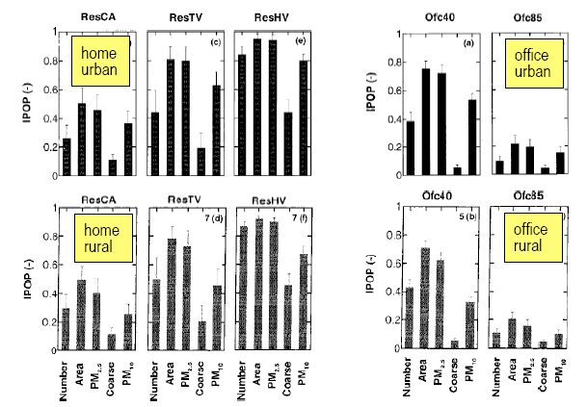
Typical Indoor/Outdoor Ratios for PM
Riley et al., 2002

Slide 53
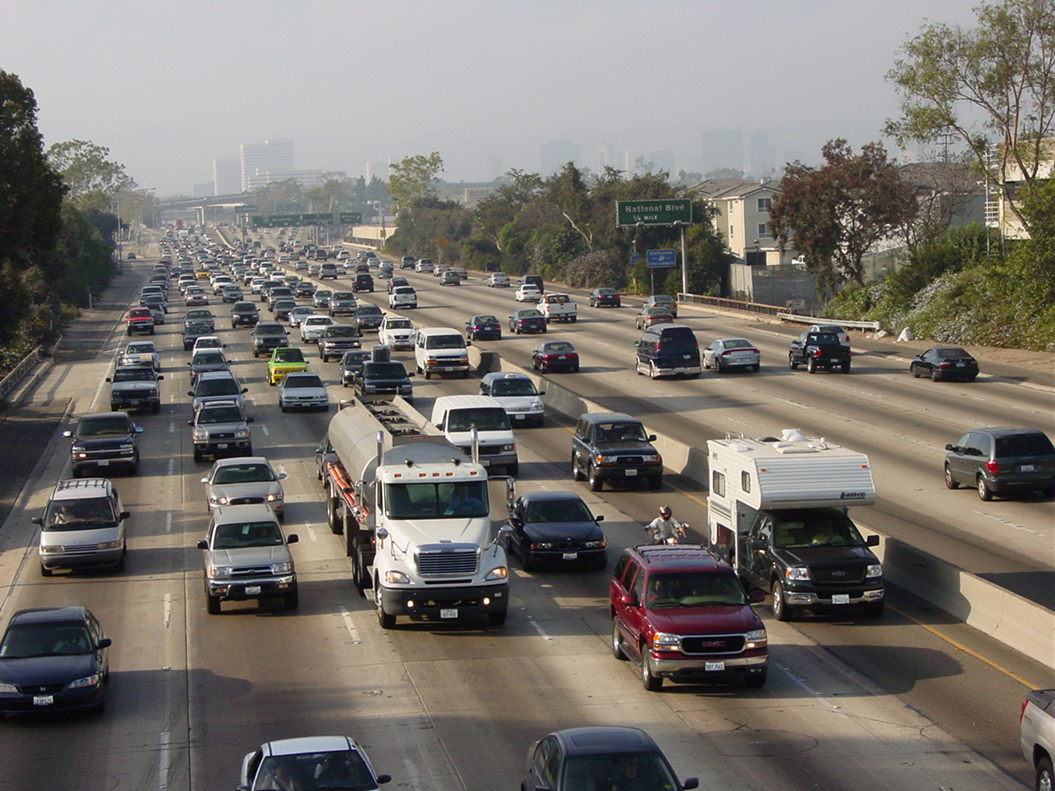
Case Study- I/O near Freeways
Zhu et al., 2005
Notes:
This is a picture showing the freeway and the studied apartments. There is a sound barrier wall made of solid concrete in between the freeway and the apartments. The distances between apartment 1 and the wall is about 15 m. The distances between apartment 2 and the wall is about 40 m. Wind is blowing this direction during the day and reverse at night. Windows in apartment 1 faced the freeway, whereas windows in apartment 2 faced parallel to the I-405 freeway. Both of the apartments are on the 3rd floor.

Slide 54
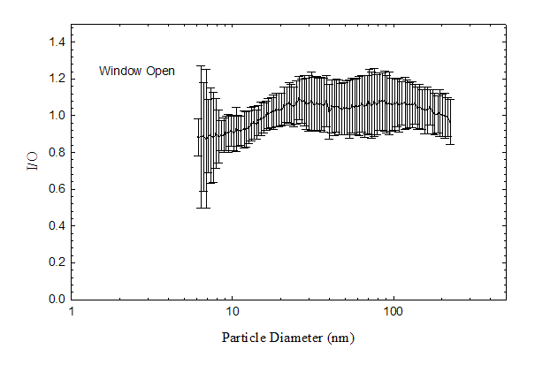
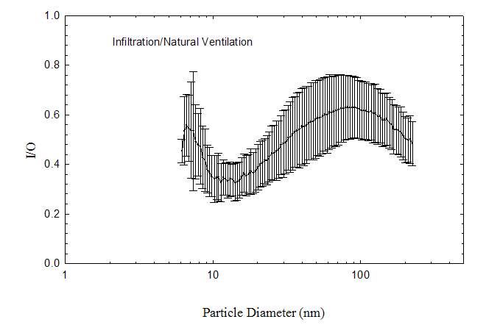
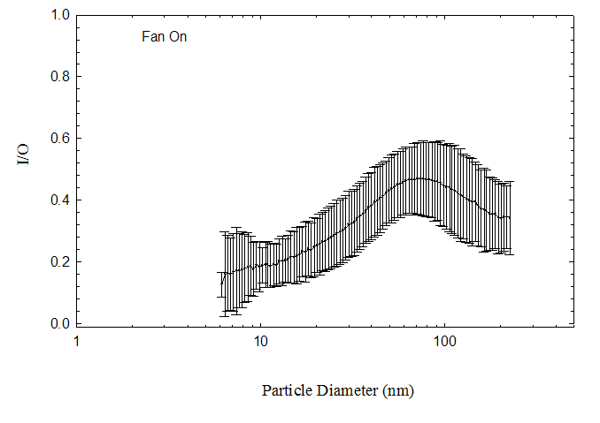
室内空气中的颗粒物
大多数人一天中有80~90%的时间处于室内，因而室内空气质量对于人体健康至为关键。
大气中的颗粒物可以渗入室内，其渗透量取决于通风条件与颗粒物粒径。
开窗
自然通风
开风扇
参考文献：Zhu YF, Hinds WC, Krudysz M, Kuhn T, Froines J, Sioutas C. 2005. Penetration of freeway ultrafine particles into indoor environments. J Aerosol Sci 36(3):303-322.

Slide 55
室内空气中的颗粒物
室内环境中也存在着颗粒物排放源，如吸烟、烹饪、焚香、使用化学喷雾剂等。
颗粒物数量
PM2.5
炭黑
（1）背景测量
（2）热锅
（3）煎肉
（4）烹饪结束
标准化浓度（%）
参考文献：Zhang QF, Gangupomu RH, Ramirez D, Zhu YF. 2010. Measurement of ultrafine particles and other air pollutants emitted by cooking activities. Int J Hyg Environ Health 7(4):1744-1759.

Slide 56
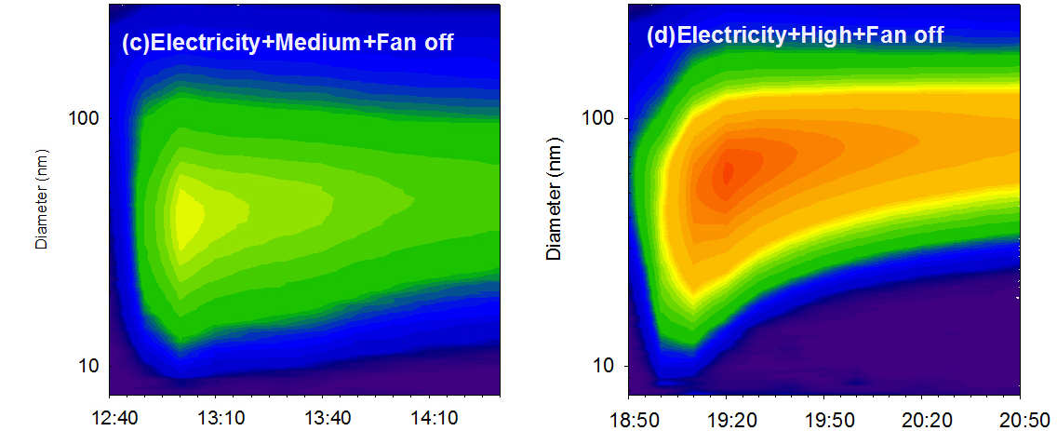
如何降低室内空气中的颗粒物
1.启用通风设备
打开排气扇
关闭排气扇
参考文献：Zhang QF, Gangupomu RH, Ramirez D, Zhu YF. 2010. Measurement of ultrafine particles and other air pollutants emitted by cooking activities. Int J Hyg Environ Health 7(4):1744-1759.

Slide 57
如何降低室内空气中的PM_{2.5}
2.使用空气净化器
2003年，美国市场上空气净化装置的销售总量为约340万台。
约30%的美国家庭拥有一种以上的空气净化装置。在加州，约14%的家庭使用空气净化装置。

Slide 58
空气净化器的种类
负离子空气净化器 （Ionizer）
高压电极使得颗粒物带上电荷，带电颗粒物在电场作用下沉降于金属电极板上，因而从空气中去除。
会释放臭氧，与室内的可挥发性有机物反应生成二次有机气溶胶。
高效颗粒物过滤器 （HEPA filter）
气流通过高效滤膜，颗粒物被滤膜拦截，净化后的空气返回室内空间。
对颗粒物的去除效率高于负离子空气净化器。

Slide 59
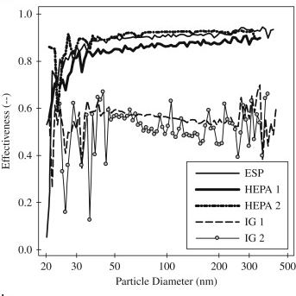
高效颗粒物过滤器的效果
洁净空气传送率（CADR）约300立方米每小时。
对颗粒物的去除效率达80~90%。
去除效率
颗粒物粒径（纳米）
参考文献：Waring et al., 2008, Ultrafine particle removal and generation by portable air cleaners, Atmospheric Environment, 42(20): 5003-5014

Slide 60
In-Cabin Exposure
车厢内超微颗粒物浓度比大气背景浓度高10倍。
一个普通加州居民，每日上下班时在车厢内对颗粒物的暴露量占每天总暴露量的30-50%。
两大因素决定车厢内的颗粒物浓度: (1)路上机动车尾气排放量；（2）道路上的颗粒物进入车厢内的比例。
Zhu et al., 2007. In-cabin commuter exposure to ultrafine particles on Los Angeles freeways.
Environmental Science and Technology 41(7):2138-2145

Slide 61
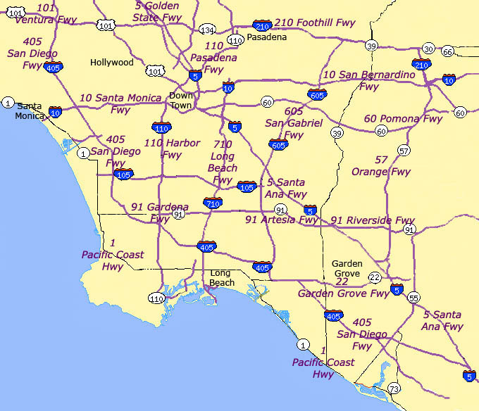
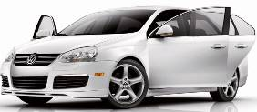


In-Cabin Exposure
110 FWY
405 FWY
710 FWY
Jetta (2002)
Audi A4 (2004)
PT Cruiser (2005)
Zhu et al., 2007 , “In-cabin commuter exposure to ultrafine particles on Los Angeles freeways”.
Environmental Science and Technology. 41: 2138-2145.

Slide 62
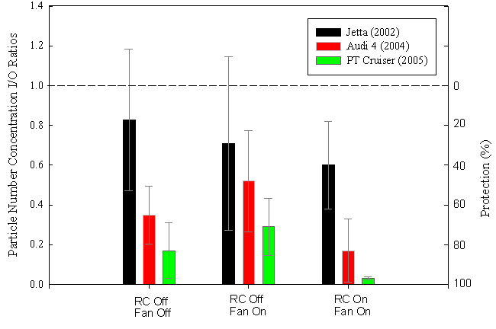
In-Cabin Exposure
车内循环
弊端：二氧化碳会累积
车内外颗粒物数量浓度比例
保护效率（%）
关内循环
关风扇
关内循环
开风扇
开内循环
开风扇
Zhu et al., 2007 , “In-cabin commuter exposure to ultrafine particles on Los Angeles freeways”.
Environmental Science and Technology. 41: 2138-2145.

Slide 63
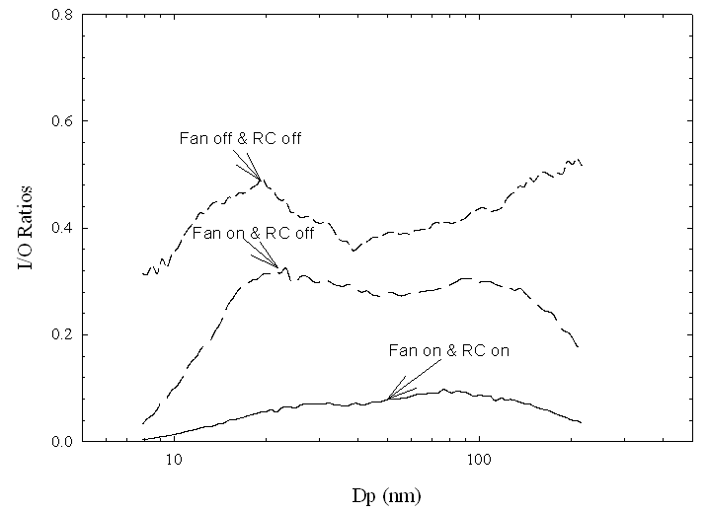
In-Cabin Exposure
打开风扇及内循环，可有效降低车内细小颗粒的浓度，但是会造成二氧化碳浓度过高。
关键点
Zhu et al., 2007 , “In-cabin commuter exposure to ultrafine particles on Los Angeles freeways”.
Environmental Science and Technology. 41: 2138-2145.

Slide 64

In-Cabin Exposure Modelling
Source
Penetration
Filtration
Sink
Recirculation
Inhalation
Coagulation
Deposition
Recirculation, Q_{r}
Penetration, Q_{L}
Breath rate, Q_{F}
Q_{s}+Q_{L}
Supply, Q_{s}
Deposition, β
Filtration, η_{s}
Notes:
64

Slide 65
In-Cabin Exposure Modelling
静态下模型结果
Fan off, RC off
Fan on, RC off
Fan on, RC on
Bin Xu and Yifang Zhu “Quantitative analysis of the parameters affecting in-cabin to on-roadway (I/O) ultrafine particle concentration ratios”, 2009, Aerosol Science and Technology, 43: 400-410.

Slide 66
In-Cabin Exposure Modelling
动态下模型结果
Bin Xu and Yifang Zhu “Quantitative analysis of the parameters affecting in-cabin to on-roadway (I/O) ultrafine particle concentration ratios”, 2009, Aerosol Science and Technology, 43: 400-410.

Slide 67
In-Cabin Exposure Modelling
Fan off, RC off
Fan on, RC off
Fan on, RC on
Mechanical Airflow
Penetration Factor
Deposition Efficient
Filter Efficiency
Respiratory
Penetration, Deposition, and Filtration 是影响细小颗粒由车外进入并停留在车内的重要因子。
关键点
Xu and Zhu 2009 “Quantitative analysis of the parameters affecting in-cabin to on-roadway (I/O) ultrafine particle concentration ratios”, Aerosol Science and Technology, 43: 400-410.
Notes:
Under which ventilation conditions, which parameters dominate

Slide 68
In-Cabin Exposure Reduction
Cabin Filter Performance: The Good, the Bad, and the Ugly
关键点
目前市场上的车内过滤装置，过滤效率不尽人意。相对好的效率可达80%， 一般的效率在50%左右， 差的只有20%。
Xu, Liu, Liu, and Zhu, 2010 ‘Effects of cabin filter on in-cabin to on-roadway ultrafine particle ratios’ Aerosol Science and Technology, Aerosol Science and Technology, 45:215–224.

Slide 69
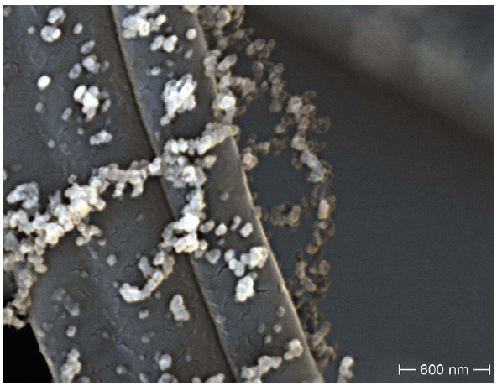
In-Cabin Exposure Reduction
HECA A Filter
HECA B Filter
Pressure drop
comparable to OEM filters
A bit more pressure drop
But, higher efficiency!
~ 1 μm
0.4 ~ 0.8 μm
Both prototype filters have particle removal efficiency much higher than OEM filters. The difference is in the filter fiber diameter.
Notes:
The major difference of the developed HEPA filter is in filter fiber diameter.
HEPA A filter used 1 um glass fibers but 0.6 um for HEPA B filter as these SEM images show.
“Smaller fiber diameter increases more interception of particles .”

Slide 70
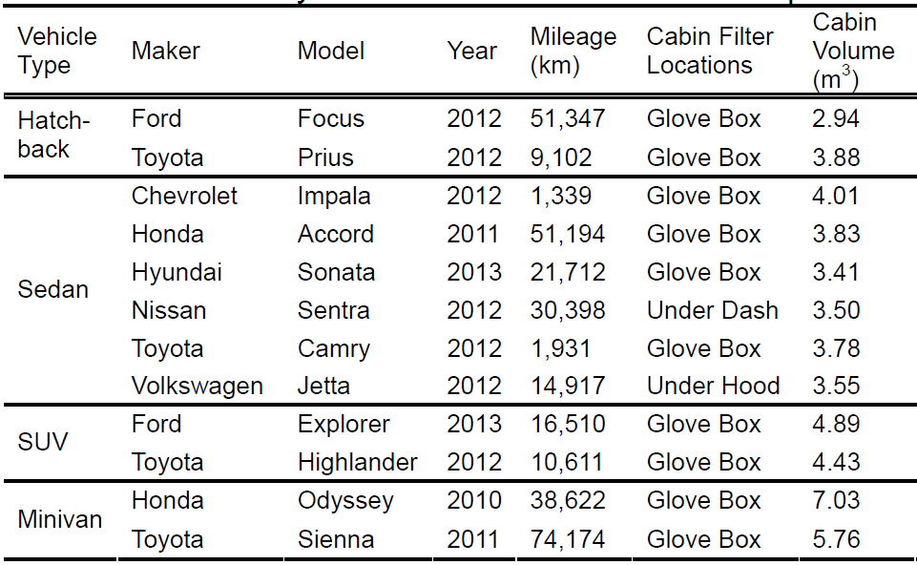
In-Cabin Exposure Reduction
Less than 3 years
California Vehicle Fleet
Notes:
We only recruited vehicle models less than 3 year old and models to represent the California vehicle fleet.
The field evaluation was conducted in OA-mode using Median fan setting.
The measurements were done for 3 driving conditions: stationary / local / freeway using 4 filter types: HEPA B, HEPA A, In-use OEM, and No filter.
“OEM is Original Equipment Manufacturer.”
The specifics of the test vehicle models are tabulated here.
The test vehicle models include Hatchback / Sedan / SUV, and Minivan from different automobile manufacturers and models.
The recruited models also have a wide range of cabin volume size.
“On-road and In-cabin concentration data were concurrently collected.”

Slide 71
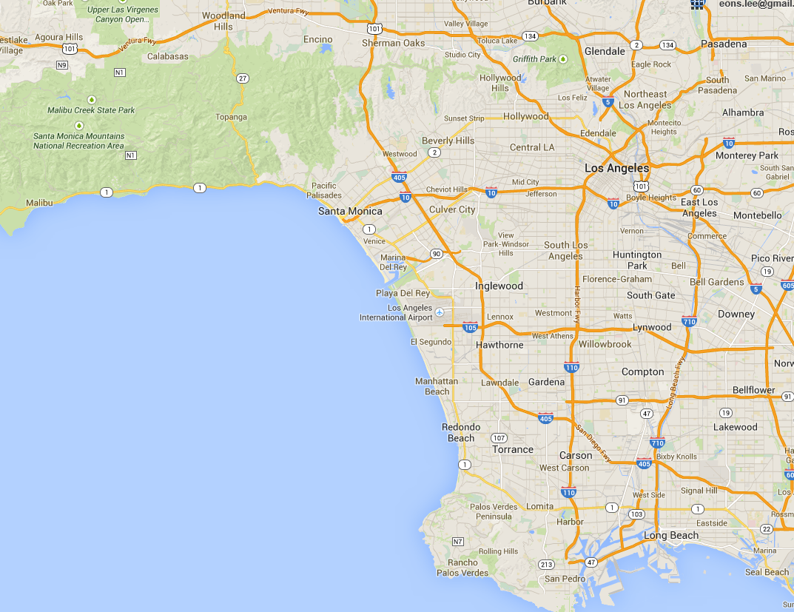
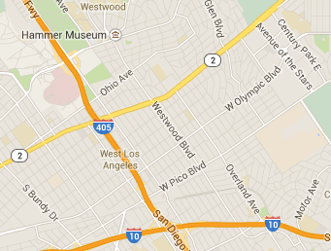
In-Cabin Exposure Reduction
OA-mode &
Median Fan Setting
Stationary
Sampling Site
4 Filtration Scenarios
  HECA B
  HECA A
  In-use OEM
  No Filter
3 Driving Conditions
  Stationary
  Local
  Freeway
0
1 km
Local Road
Sampling Route
Freeway
Sampling Route
0
5
10 km
Map data © 2015 Google

Slide 72

In-Cabin Exposure Reduction

Slide 73

In-Cabin Exposure Reduction
关键点
93%
在车内使用高效颗粒物空气（HECA）净化器，可有效的降低车内PM2.5和超细颗粒物的浓度，从而降低人群暴露水平，保护公共健康。
Higher Efficiency!
Less Variability!
75%
40-60%
25-50%
For each driving condition, HECA B and A filters provided significant in-cabin UFP reductions (p < 0.001) in comparison to OEM or no filter scenarios.
Lee and Zhu 2014, Environmental Science and Technology, 48(4):2328-35.
Notes:
“No Filter could also provide 25-50% reduction; OEM helped just a little more reduction; but, HEPA B filter ….”
Higher Reduction Less Variability.
UFPs: Source particle size distribution.
In Freeway conditions,
Nucleation mode particles / filtration by diffusion.
Number concentration is more sensitive to diffusion loss.
Black Carbon (BC) & PM2.5
Mass concentration is less sensitive to particle diffusion.
Measurement at wider size range for BC (~ 1 μm) and PM2.5 (~ 2.5 μm).
At higher driving speed, more infiltration allows (unfiltered) high particle concentration; thus, less overall reduction on freeway than on local.

Slide 74
In-Cabin Exposure Reduction
Outside
Inside
Stationary Condition
Substantially decreased
UFP number concentration
Freeway Condition
UFP was reduced by
an order of magnitude
Notes:
“In the stationary condition, in-cabin reduction happened immediately and was not affected by ambient concentration changes.”

Slide 75

In-Cabin Exposure Reduction
Stationary
-20%
Freeway
-8%
Pressure drop is present but would unlikely become a problem.
On Freeway,
Air-flow reduction is
Less than 10%!
306 m³/h
Black arrow indicates the averaged ventilation airflow rate of 12 vehicle models at the median fan setting (306 m³/h).
No
Change
Notes:
“Thermal comfort would be an unlikely problem.”

Slide 76

In-Cabin Exposure Reduction
Means & Standard Deviations
of measurement data from 12 passenger vehicles
> 2500 ppm CO₂
开发使用车内高效颗粒物空气（HEPA）过滤技术及产品，对降低车内PM2.5和超细颗粒物的浓度，保护公共健康，具有广阔的前景和积极的社会意义。 该技术还可有效克服打开车内循环所造成的二氧化碳堆积问题。
关键点
635 – 924 ppm CO₂
Notes:
In OA mode, a significant UFP I/O reduction with HEPA B filter.
In RC mode, better reduction than in-use OEM.
In RC mode, CO2 accumulates above 2500 ppm.
But, in OA mode, CO2 remained at 600 – 900 ppm.

Slide 77
如何降低个人对大气颗粒物的暴露水平
避免在交通繁忙时段在户外活动。
避免在车辆往来频繁的道路下风向活动。
户外
室内
控制室内颗粒物污染源。
改善室内机械通风或者使用高效颗粒物过滤器。
车内
车内乘客较少时，可以使用内循环风。
将现有的车厢空气过滤器更换成高效颗粒物过滤器

Slide 78
Thank You
Q/A and Discussion
yifang@ucla.edu

