Slide 1
Whither Urban Water Policy in California: Regional Implications
California Center for Sustainable Communities
UCLA Institute of the Environment and Sustainability
Stephanie Pincetl and Erik Porse
March 22, 2017

Slide 2
California escaped a four year drought with floods – how should urban areas respond?
More people and a changing rainfall regime
  Likely drier dry years and wetter wet seasons
Urban regions are impermeable
Most regions use 50% or more of their water on outdoor landscapes
Our urban water systems are leaky, rely on imported water and expending used waters to sea
EO B-37-16 (2015) states a need to change state water use patterns and establish new norms
  “Conservation as a way of life”

Slide 3
Promoting Efficient Landscapes
Water Efficient Landscape Ordinance (MWELO)¹
  Landscape conservation legislation dates back as far as 1990
  Established Maximum Applied Water Allowance for new construction
2015 Updates
  Increased conservation and integration with retailer residential water budgets
  Conservation and water efficiency to better create new beneficial landscapes
  More consistency across across jurisdictions
Broader approach
  Maintain life in the soil
  Minimize energy use by reducing irrigation, petroleum based fertilizers and pesticides and maintaining Tree Canopy Cover
  Capture and reuse rainwater and graywater
¹DWR Title 23 Chapter 2.7 Model Water Efficient Landscape Ordinance

Slide 4
MWELO: Gritty Details
Applies to new construction projects with an aggregate landscape area equal to or greater than 500 sq ft. . .
Rehabilitated landscape projects with an aggregate landscape area equal to or greater than 2,500 sq ft
    And more details
Requires automatic irrigation controller using either evapotranspiration or soil moisture data
Use a certified irrigation designer and irrigator
Establishes a maximum applied water allowance based on a formula taking into account mulch, different land use types, types of irrigation systems, plant factors, uses, recycled water and more.

Slide 5
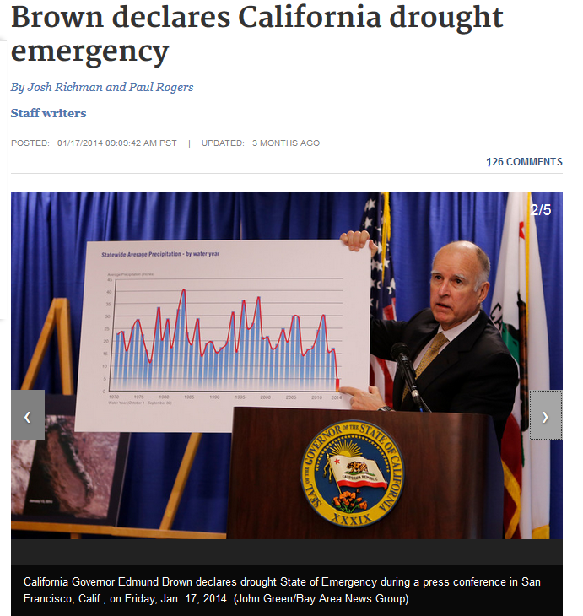
Point of MWELO
Over half of urban water is used for landscape irrigation.
MWELO is to improve water savings in this sector
Phased transition to climate appropriate landscapes
Potential obstacles
  Poor plant selection in nurseries
  Poor skills in irrigation technologies
  Poor skills in landscape maintenance of different
  types of plants
  Cost of conversion

Slide 6
Zero Net Water –Another Strategy
Zero Net Water, or neutrality of water demands, is another strategy
Cities and utilities have existing ZNW ordinances
  Cambria
  City of Big Bear Lake
  Lompoc
  Morro Bay
  Napa
  Oxnard
  City of St. Helena
  San Luis Obispo
  And East Bay Municipal Water District
Cities can grow and maintain or reduce overall water consumption

Slide 7
Requirements and Benefits
Often 2:1 match requirement for new development
Offset fees (with clear nexus to new developments’ needs)
  Banked for funding efficiency programs in same territory on a water use per bedroom rate
    Retrofitting landscaping and irrigation of city public spaces
    Low cost housing subsidy to replace leaky plumbing
    Expanding purple pipe infrastructure
Water Credits
  Fund stormwater capture or wastewater reuse
Implementation of on-site water recycling and reuse

Slide 8
Effects
Adds extra cost to development
May bring conservation to low income residents
Provides funding for new conservation technology and techniques and incentivizes quantitative approaches to demand management
May delay impacts of additional water demands
Requires implementation and monitoring for compliance

Slide 9
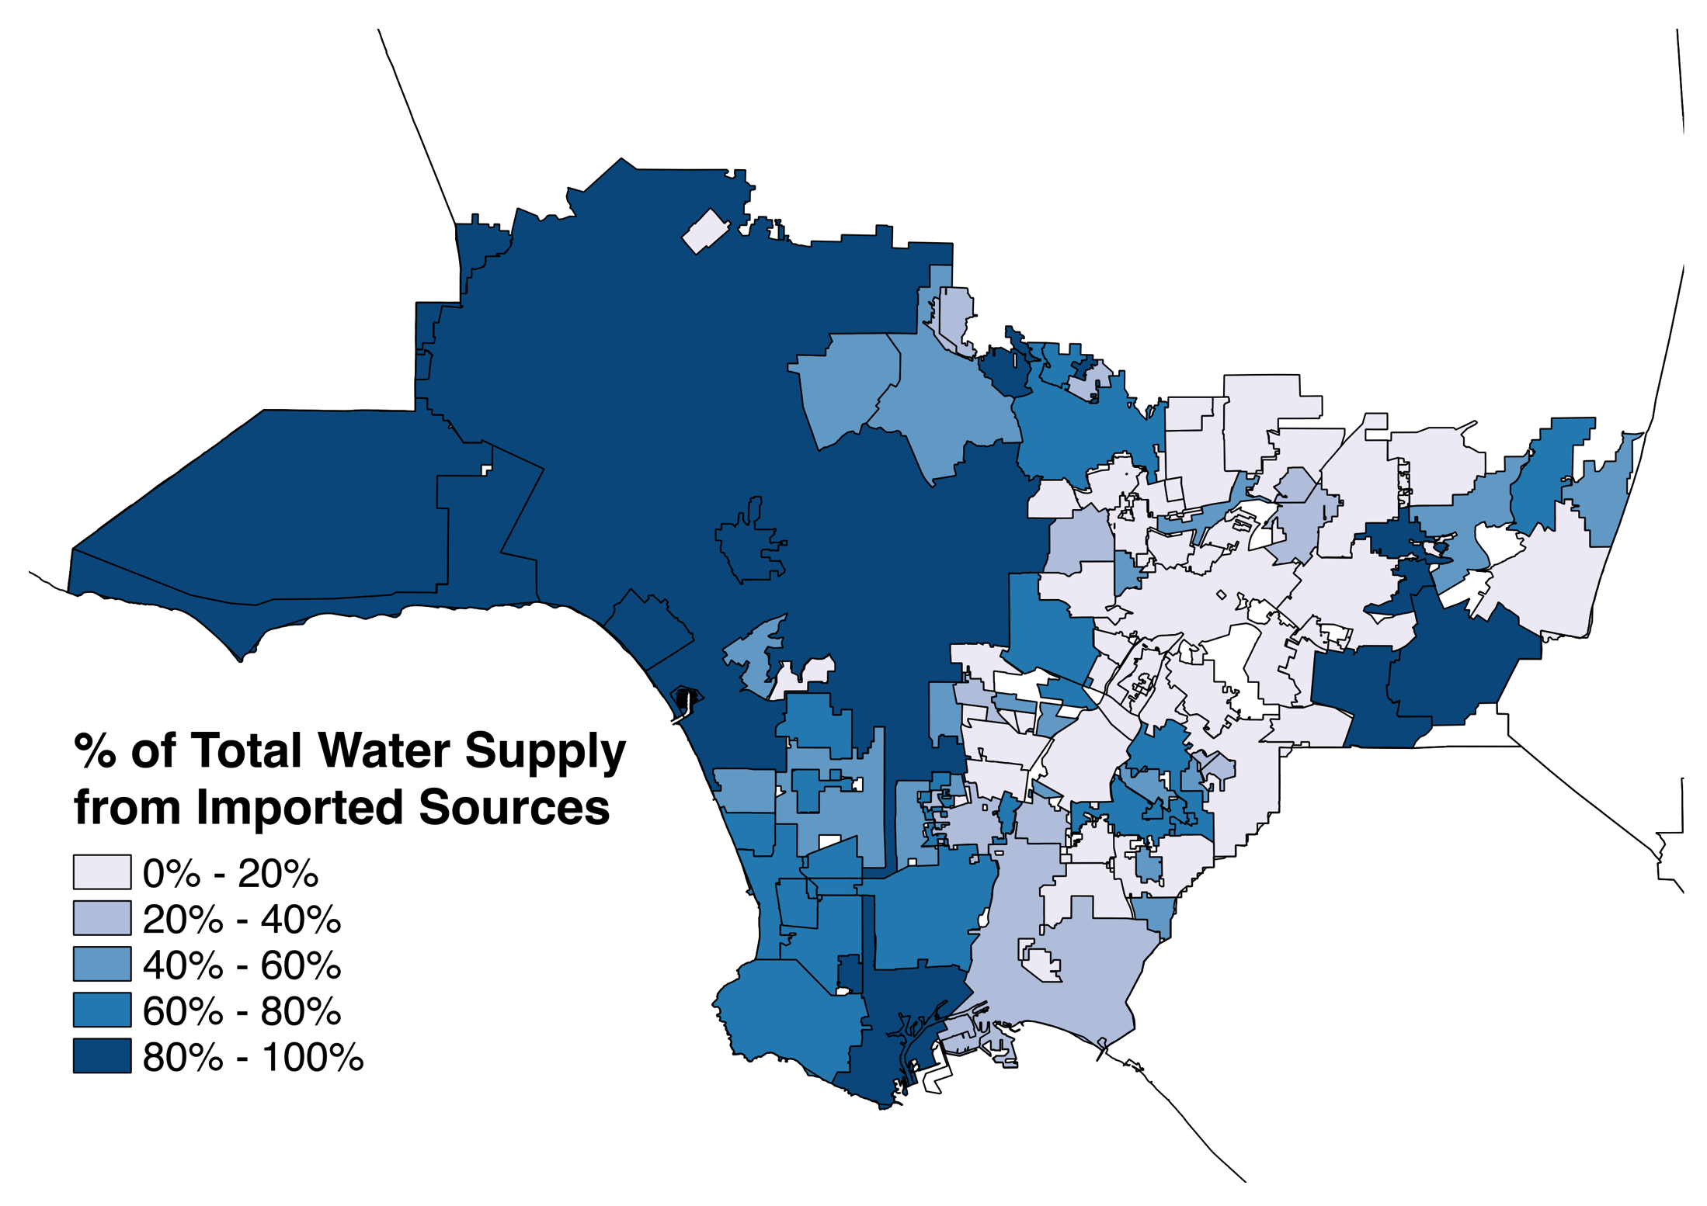
Other Considerations
Los Angeles County
  88 cities, over 100 different water delivering entities
    Public
    Private nonprofit
  Very different fiscal capacities for
    Turf replacement or MWELO incentives
    Finding and repairing leaky infrastructure
    Implementing new tiered rates
    Implementing conservation programs that will
    lead to reduced revenues without tier rate changes

Slide 10
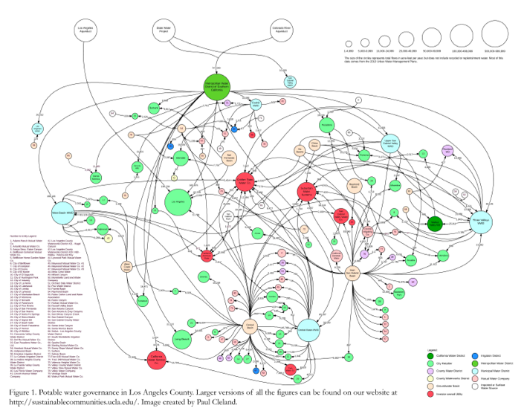

Slide 11
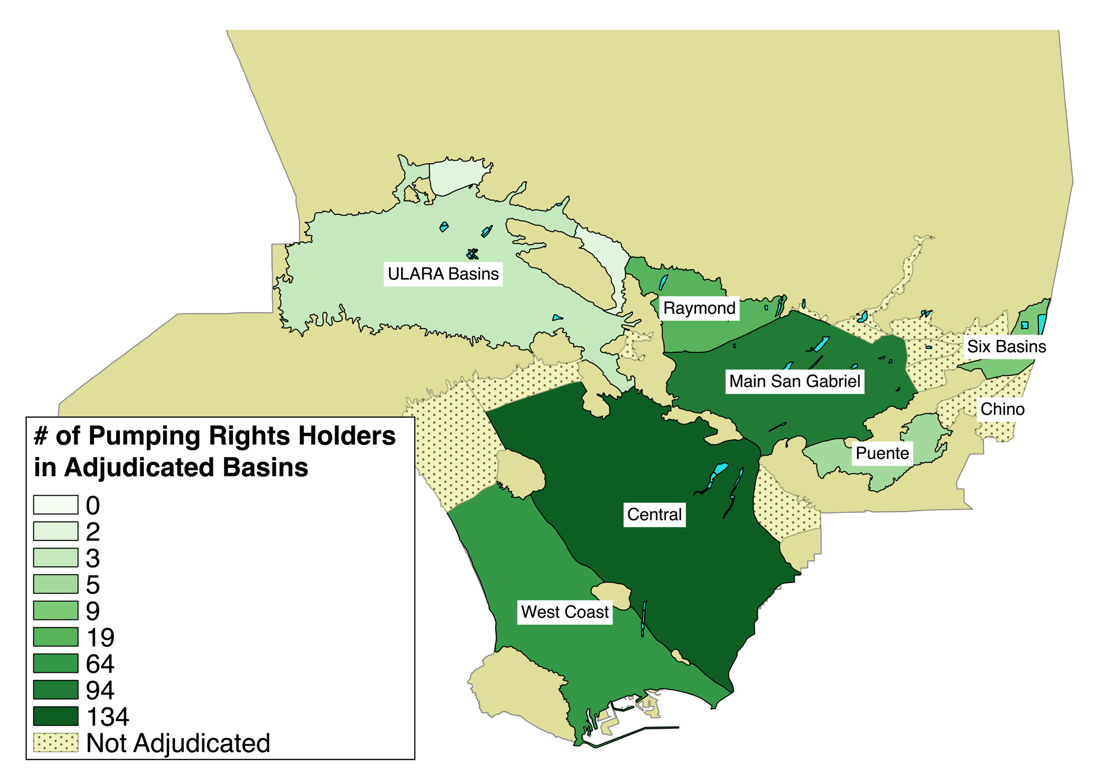
Groundwater adjudications
Groundwater rights are legally inscribed as a property right
Groundwater storage amounts are fixed in the adjudications
Numbers of cities have no groundwater access
Adjudications preclude using groundwater
resources conjunctively as a regional
resource

Slide 12
Water is sliced and diced, regulated and managed in a segmented manner
  Water supply
  Stormwater
  Wastewater
  Return water
  Groundwater
  Recycled water
  Purple pipe water. . . .
  And managed by different agencies

Slide 13
Conclusions
There are many ways yet to conserve water
We need resources to do so at all scales
Water management needs to move towards One Regional Water

