Slide 1
Resilience Team
-Midterm Presentation-
Lea Le Rouzo - Nick Caton .
Anh-Vy Pham - David Scolari - Sophia Bozone - Tory Coffin
Stakeholders: Amy Shadkamyan and Nurit Katz
2019
Notes:
The presentation should include the following:
● Introduction of your project
● Goals
● Progress
● Challenges
● Plans for spring

Slide 2
Project Overview
“The capacity of individuals, organizations and communities to survive and thrive in the face of stressors and shocks” - Resilience LA
Resilient Los Angeles
Working to become the first university to develop a plan
Delivering recommendations to authors of UCLA’s future plan
Notes:
Tory (30 seconds)
Resilience as defined by Resilience LA is: the capacity of individuals, organizations and communities to survive and thrive in the face of stressors and shocks
LA comprehensive resilience plan “Resilient Los Angeles” published in 2018
features 96 actions to meet 15 goals to turn L.A. into “the strongest and safest city in the world.”
These include: disaster preparedness and recovery, and economic security
UCLA as one of the first universities to adapt a resilience plan
The objective of our project is to identify existing groups on campus that do work related to each resilience goal or lack thereof to recommend to the author’s of UCLA’s plan
http://www.resilience.la/#intro

Slide 3
Progress
Matched applicable items from Resilient Los Angeles with a program and point of contact at UCLA
Established new strategies unique to the UCLA campus
Researched the strengths/challenges of the current state
Developing recommendations for UCLA’s task force
Notes:
sum all of these up into one sentence (15 seconds)

Slide 4
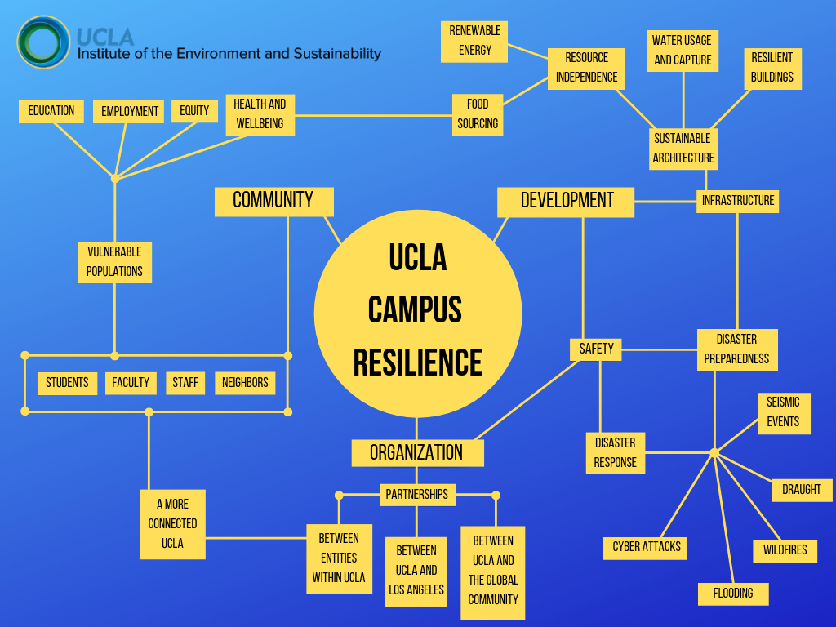

Slide 5
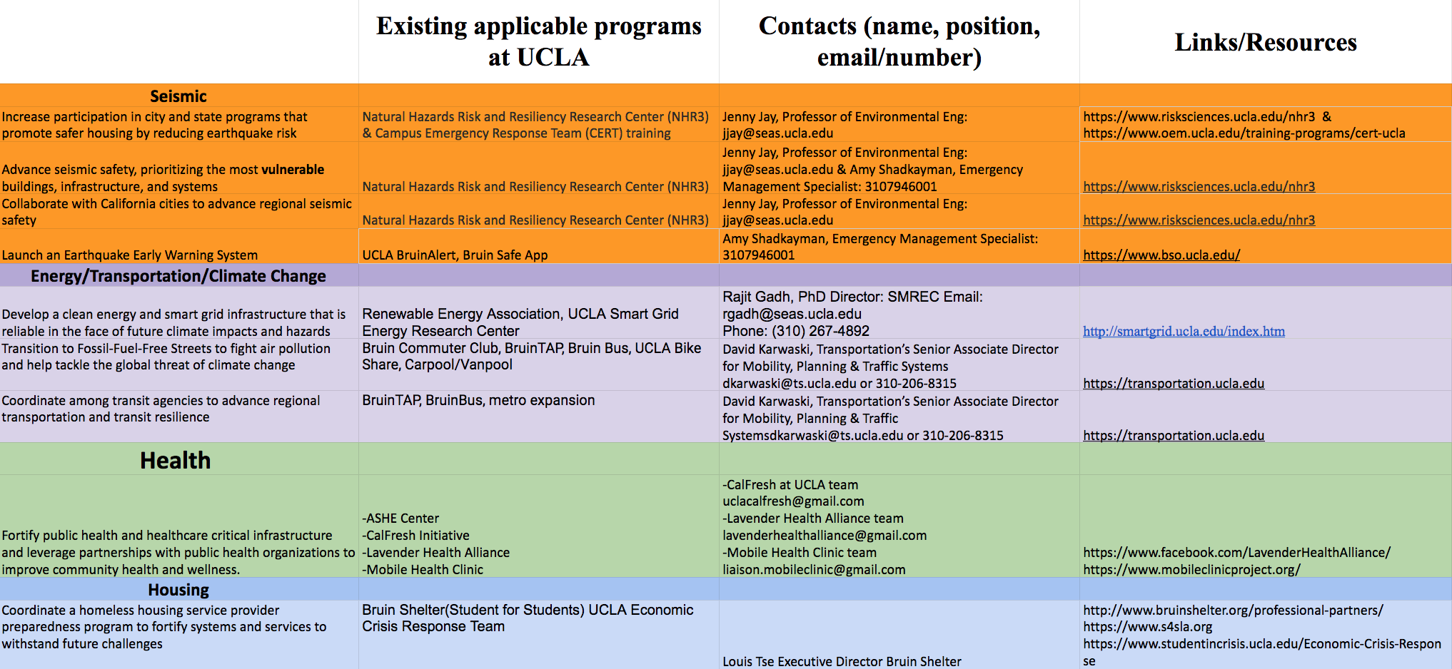

Slide 6
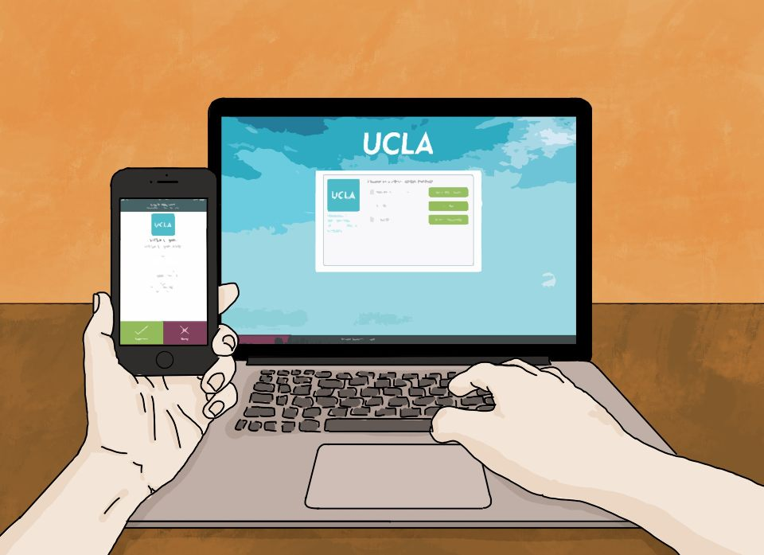
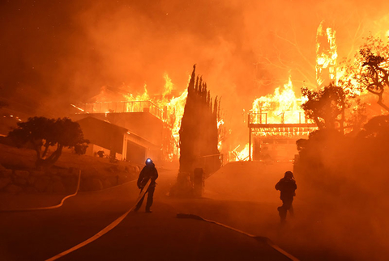
Safety
Challenge: Wildfire Preparedness
Strength: Cyber Security
Notes:
Nick:
Three resilience goals for cyber: Protection, Collaboration, Education
UCLA is a huge target for cyber attacks
programs/strategies to protect both Bruins and critical infrastructure
Everyone’s favorite: Multi-factor Authentication
Innovative Incubatorish: PhishBowl
Education: CyberSafe Bruin Blog
Most of us in the room remember the Skirball Fire last year during finals week
Weakness: UCLA Fire’s resources are only focused on reactionary plans, not on prevention
Recommendation: Establish a wildfire task force like the one proposed in LA County
Collaborate with USC’s National Center for School Crisis and Bereavement to increase resilience network and disaster preparedness

Slide 7
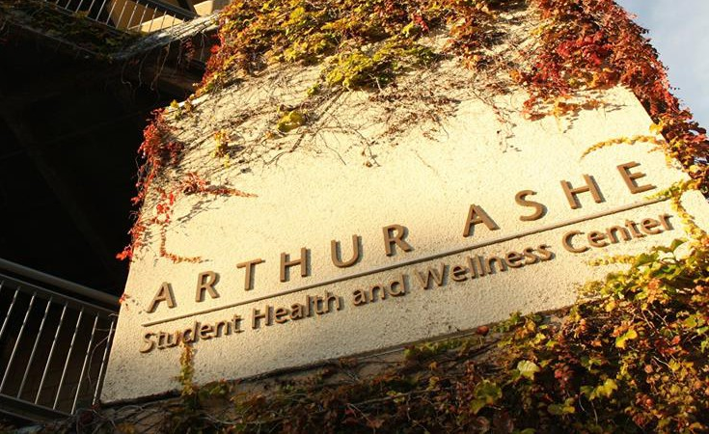
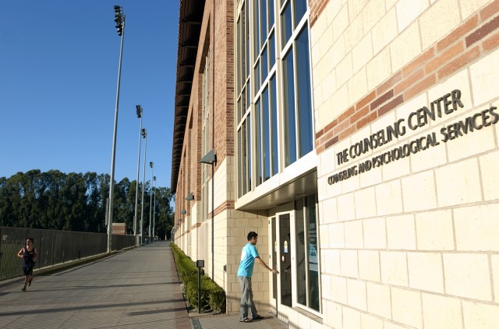
Health
Strength: Public Health and Healthcare Critical Infrastructure
Challenge: Long-Term Mental Health Resources
Notes:
Strengths in public health network: ASHE Center as most established resource, connected with other resources for students like HCI, Lavender Health Alliance, Mobile Clinic.
Weaknesses: Mental health on campus (which has more to do with personal resilience, something that falls under the greater umbrella of resilience). Sessions are limited.

Slide 8
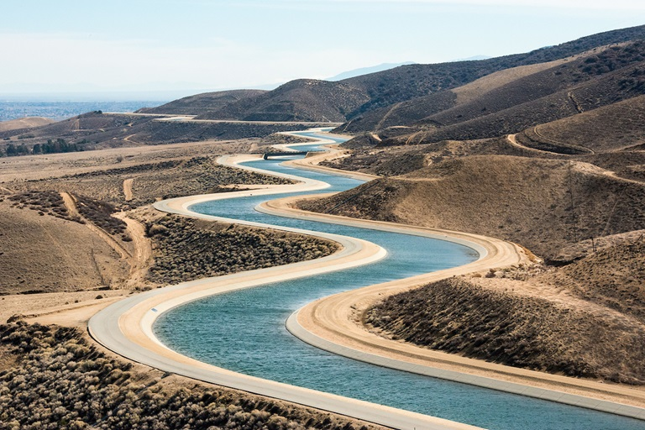
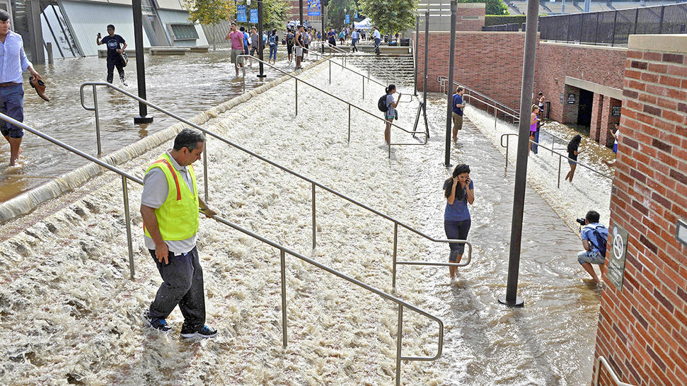
Water
Strength: Decreased Dependence on Imported Water
Challenge: Flood Risk Management
Notes:
LA Goal: reduced dependence on imported water and strengthen local water supply
UC goal to reduce all campuses’ water consumption by 2020
UCLA Water Action Plan
report that identifies a number of key areas where UCLA can lower its water consumption including: developing drought-resistant landscapes (conversion of IM field to turf)
Grand Challenges
Published research on how LA can achieve 100% locally sourced water by 2050
Includes capturing more local stormwater
LA Goal: Leverage flood mitigation infrastructure to enhance local water availability.
While Los Angeles does not experience significant rainfall annually, UCLA is still subject to potential flooding:
UCLA experienced a major flood in 2014 resulting in $13 million worth of damage
Also a more recent flood (2018) in Murphy due to rainfall
Recommendation:
School of Engineering’s “Hydrology and Water Resources” team conducting research to best address the implementation of flood mitigation infrastructure at UCLA
Which could include incorporating more permeable pavements ((and ensuring that all future building projects include adequate flood mitigation technology))

Slide 9
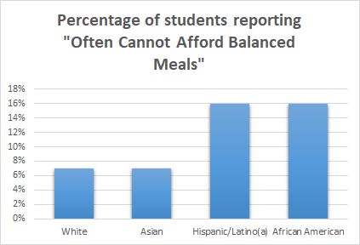
Vulnerable Populations
Shocks such as natural disasters, economic instability, and political uncertainty may have varying effects on different populations.
UCLA is home to a lot of young people who may not be well equipped to meet their basic needs.
Notes:
David

Slide 10


Equity
Challenge: Linguistic Inclusivity
Strength: Food Insecurity
Notes:
Anh-Vy
Strength: Food Insecurity Amongst Students
-a 2016 study found that 40% of university students are food insecure
-there are many programs at UCLA that try to help students with food insecurity, such as the UCLA CPO food closet, UCLA (Economic Crisis Response) ECR Team, Swipe Out Hunger, etc etc
-there is room to improve by possible merging programs to create one main functioning unit that tackle food insecurity
Challenge:
-UCLA Office of Equity, Diversity and Inclusion
-UCLA Center for World Languages
-English is a dominant language on the UCLA campus and therefore other languages are hidden in the shadows
-looking into this would be a way to further highlight the diversity of the campus in a more tangible way whether its through programs, written publications, etc.

Slide 11

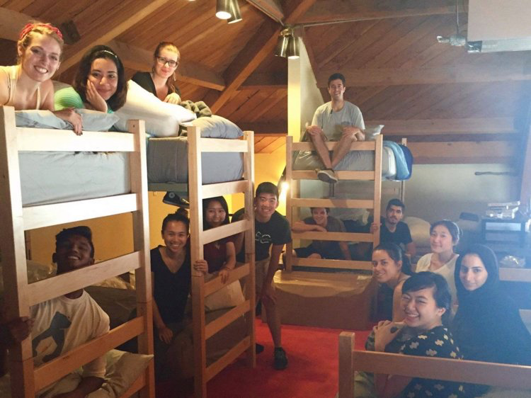



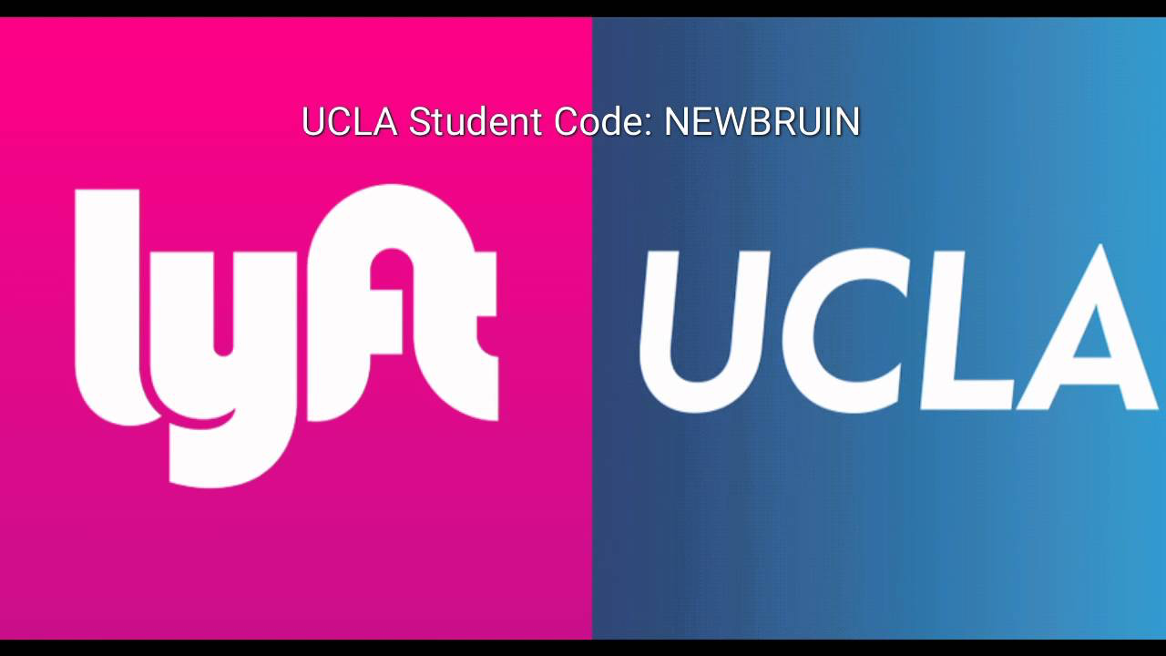

Energy, Transportation, and Misc
Strength: Transportation Infrastructure
Challenge: Homeless Student Support

Slide 12
Challenges
Breaking down silos to find the contacts we needed
Working among unfamiliar technical fields
Adopting goals that didn’t fit our initial plans
Notes:
Sophia

Slide 13
Plans for Spring Quarter
Deliver recommendations to resilience task force
Create signage for previous SAR teams’ rainwater cistern
Outreach event to educate UCLA community on resilience
Earth Day Fair
Notes:
Nick/Lea

Slide 14
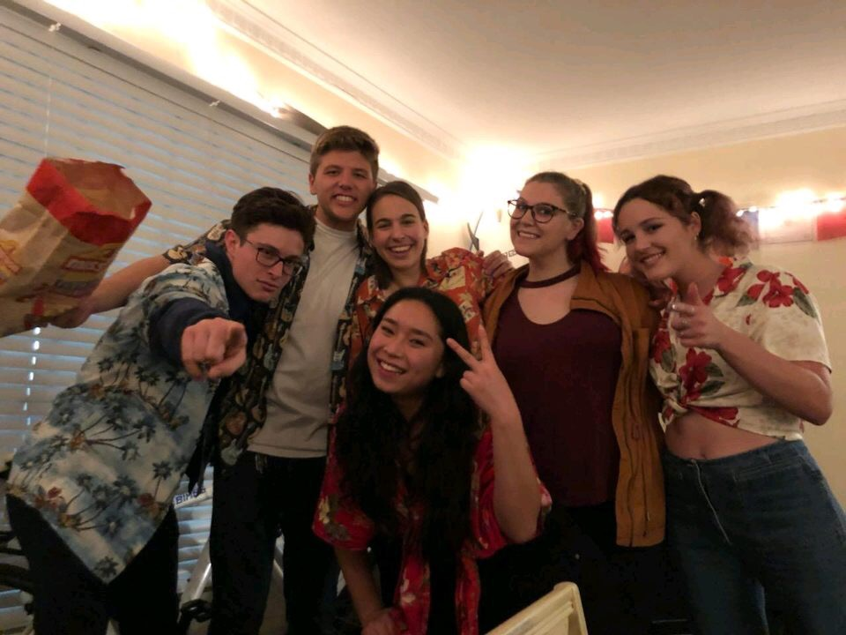
Questions

