Slide 1

What Will it Take for an Energy Transition to be Just?
Stephanie Pincetl
Institute of the Environment and Sustainability
UCLA
March 2022

Slide 2

My talk today
Overview to the issue of Energy transition
  A dive into the weeds of energy use and regulations: justice arises from the details
Our work
What the driving issues are
How to move forward

Slide 3
Ultimately the fight for a just transition is a fight for justice
The fossil fuel transition means every sector and segment of society will be impacted:
Electrifying appliances and vehicles = utility and gas station closures; losing tax bases in local communities, higher bills and potentially a lot of land use trade offs.
Will dramatically reduce pollution, but create other types, in other places
Is absolutely critical
An energy transition is not necessarily a transition to society whose benefits are more equitably distributed, nor one in which the economy is more socialized
That requires more than an energy transition, it requires re-embedding the economy in society, and a move away from high energy, high consumption modernity

Slide 4
A Just Transition Requires
An Equitable distribution of the benefits of both non-fossil energy and the non-fossil energy economy.
This requires that all communities, particularly historically burdened communities,
  1) have access to affordable to non-fossil fuel energy and especially access to cleaner air as the result of reducing reliance on fossil fuel;
  2) have access to the good, high-quality jobs created by the clean energy economy; and
  3) be shielded, if lower income, from any higher energy costs that might result from the transition.
It requires that high income communities pay their fair share, and their footprints be substantially reduced.

Slide 5
A Just Transition also requires understanding limits
Earth systems are limited
They have been, and continue to be despoiled
We live on the back of a history of colonialism and imperialism and the exploitation of people of color
High technology market-based modernity will not lead to a just transition
  More sensors, more smart technologies
  More extraction from far flung places
  More ‘profit’ opportunities that simply continue the same path

Slide 6
Another way to talk about it
Not simply as a “just transition” but also as a “transition to justice” in the sense of centering racial, economic, and environmental equity in all policy arenas, and this includes rethinking the economy, deeply
How just transition policies develop is integral to whether the transition is just.
The need for a third path involving more appropriate technologies (not happening)

Slide 7
Our Work
Understanding we are privileged and work in an academic institution which has its own constraints, rules, processes and procedures
Our work is aimed at producing science in the public interest, and working with underserved communities as best as possible
We seek a dialectic between theory and the experiences of every day lives of people, especially the most disenfranchised
We start by look at place and people, land use and regulatory regimes, distributional questions of over and under consumption

Slide 8
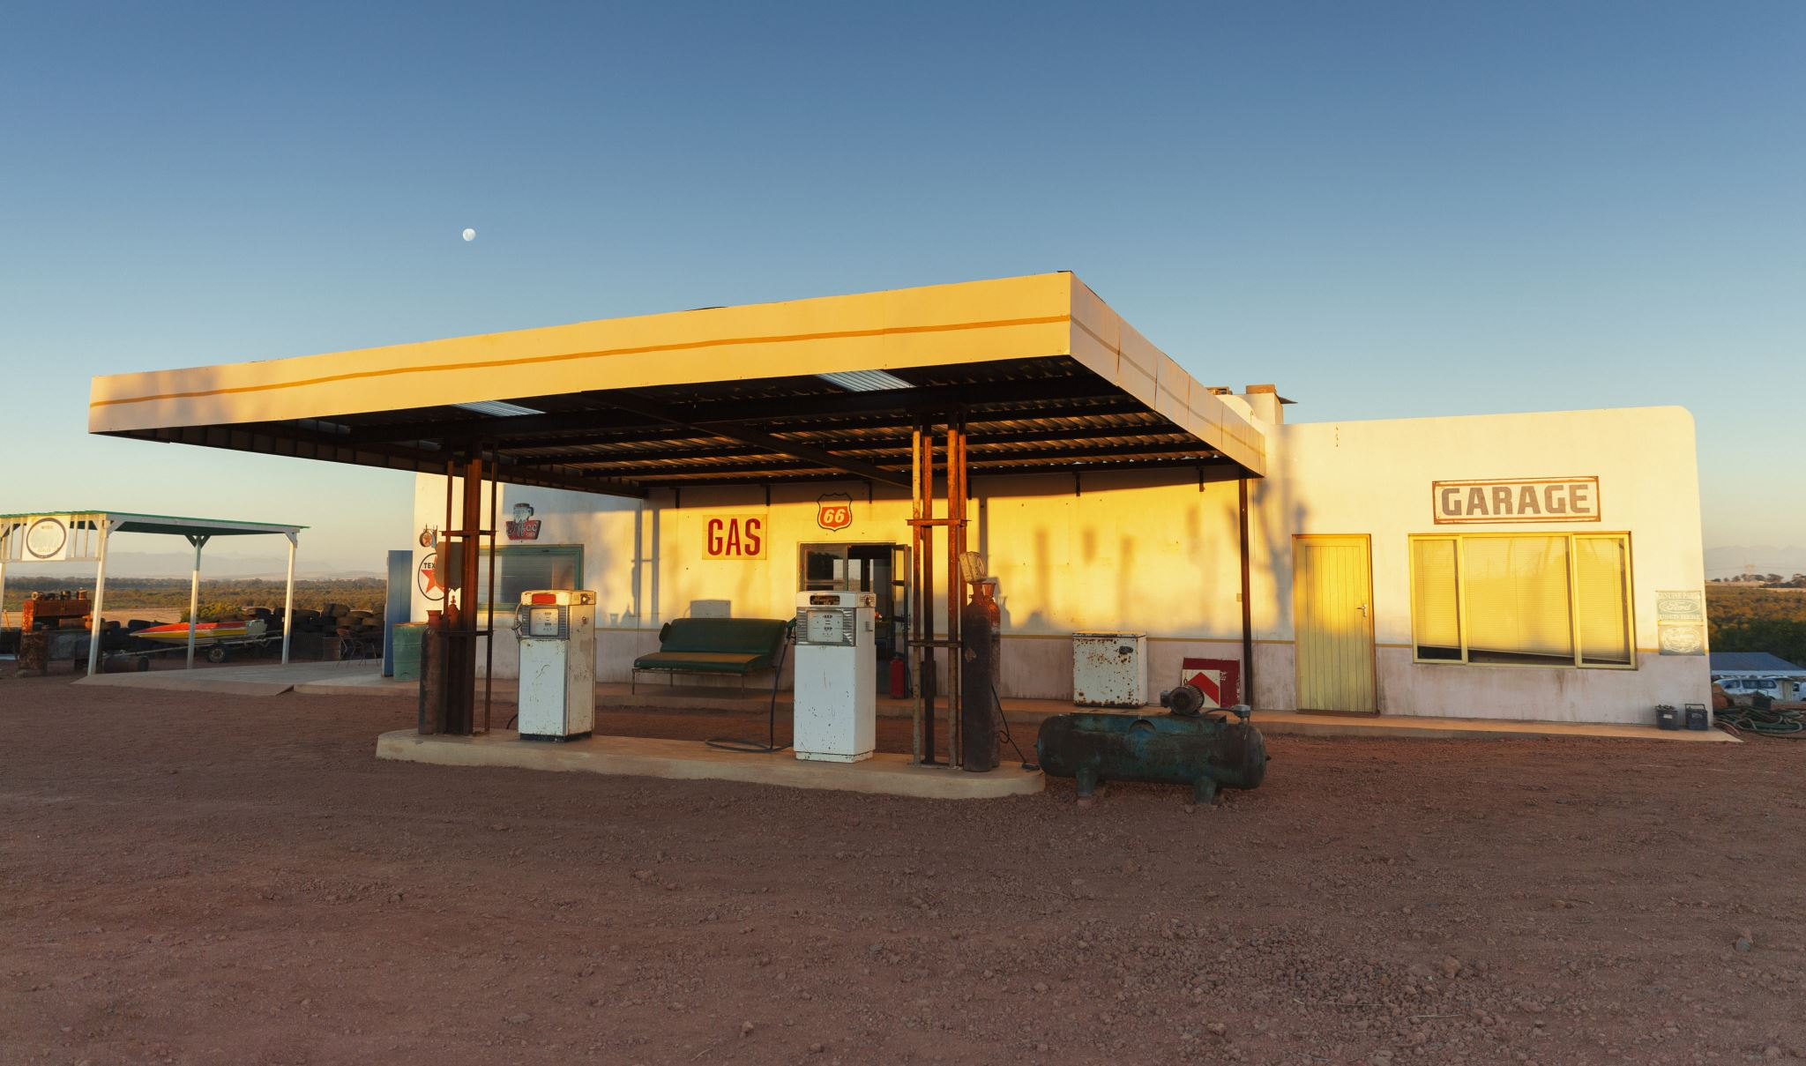
Starting with consumption, the ground up
Buildings are responsible for about 40% of GHG emissions.
California has been decarbonizing its electricity grid, but natural gas remains a big part of building energy consumption
Yet, generally it has not been known how much energy is consumed in buildings: electricity and natural gas
12 years ago, I participated in a California Public Utilities Commission proceeding about obtaining data
In alliance with local governments, I made the case for the need to obtain parcel level consumption data. The Administrative Law Judge concurred

Slide 9
Over A Decade Later
UCLA Energy Atlas Southern California https://www.energyatlas.ucla.edu/
  San Francisco Bay area https://bayarea.energyatlas.ucla.edu
Solar Opportunity Tool https://solar.energyatlas.ucla.edu
Using parcel level billing data as the foundation for the work, we match that information (many billions of records) to building attributes: age, size, type; sociodemographic characteristics; Cal Enviro Screen; the grid, climate and more
This is used to decipher differences in consumption across landscapes over time and then policies and programs for electrification and the ways they limit a just transition

Slide 10
The backend data of these public facing websites offer the ability to understand real patterns and correlations
Our work, in contrast to most, such as that conducted at the national labs, is not based on modeling, it is based on:
Real date. This is important as modeled data is often inaccurate, and/or so generalized it cannot reveal differences that affect people’s daily lives
Ground up data is indispensable to a just energy transition

Slide 11

Some lessons learned
Wealthier neighborhoods in Los Angeles consume 10 X more energy per capita than their less wealthy counterparts
Their homes are more efficient per square foot – newer and built under California’s increasingly strict energy efficiency standards, Title 24, initially instituted in 1978. But their sheer size overwhelms any conservation benefits from efficiency
Smaller homes, though leakier, use less energy
The underserved are not addressed in the EE efforts ongoing today
The upshot:
Keeping homes smaller alone, would have reduced energy use more than any of the conservation measures put in place

Slide 12

The Jevons Paradox an old, and inconvenient lesson
An increase in efficiency in resource use will generate an increase in resource consumption rather than a decrease
In CA. the Industrial (-4.3%), Residential (-3.9%), and Transportation (-5.1%) sectors have seen only marginal GHG decreases compared to 2000
A presentation to the California Air Resources Board last week said state climate goals could boost demand for electricity by as much as 90 percent by 2045.

Slide 13
But EE programs and policies continue to prevail as the way to reduce energy consumption and GHGs
EE misses those in energy poverty: you need money to participate
EE does not sufficiently curb absolute consumption
EE for the rich is expensive, and does not curb energy use

Slide 14
The Other Elephant in the Room: NATURAL GAS
NYC – banning combustion in buildings
Cities in CA. banning natural gas
But electrifying natural gas will require significant changes
Electricity panel upgrades
Running new wiring and plugs
Changing out space and hot water heating
Changing out cooking ranges

Slide 15

Who pays and who benefits?
New buildings are one thing, retrofitting is another
In Los Angeles, for example over half the population rents

Slide 16
Community Solar– a seemingly obvious alternative when there is low home ownership – a democratic alternative
Collectively-owned solar generating systems that accept investment from a range of participants and returns benefits to them have been around for awhile, but the evolution of federal and state energy policy regimes has limited what kinds of system configurations can be implemented, and narrowed the range of feasible community solar business models. And this is even more prevalent in low income communities.
Ca. community solar systems are implemented through utility-sponsored programs designed for the recruitment of participants, site hosts, contractors, and system operators, as well for the distribution of benefits to participants. All community solar systems in California are in front of the meter.

Slide 17
Electricity– Community Solar: the policy regime
Under current CPUC regulations and IOU* program offerings, sites that are used for Community Solar projects must be developed in front of the meter (IFOM),
They are developed by a private entity.
For these types of sites in Southern California, SC Edison’s Integrated Capacity Assessment (ICA) metrics are applied.
We used the solar potential of each eligible site presented within the Community Solar Opportunities Map tool to compare to the ICA capacity of its nearest adjacent circuit segment, it was found that one-third (33%) of the total identified solar potential would likely be constrained from development due to current insufficient circuit capacities.
IOU: Investor owned utility

Slide 18
Electricity – Resilience Centers: the policy regime
Resilience Centers, by definition, require energy storage systems, they must be interconnected to the grid from behind the customer meter and are subject to Net-Metering tariffs and interconnection rules.
Rule-21, which governs the interconnection of these types of behind the meter (BTM) DER systems within California, references a capacity metric known as the 15% Penetration Limit of the host distribution circuit. These limits are calculated as 15% of the historical (previous 18-month) maximum loads encountered on each circuit.
According to this capacity metric, over 85% of the total solar potential identified across all of the CSOM tool’s eligible sites would likely be constrained from development as Resilience Centers

Slide 19
Electrification
Grid interconnection
  To date DERs serve primarily for load shedding or demand response
  Thus sizing of system components that are allowed to interconnect to the grid from behind the meter have been restricted in order to limit their potential to be net suppliers of power.
  Utilities have voiced concerns that the creation of a true bi-directional pro-sumer networks is likely to destabilize grid operations without the significant addition of automated hardware and software controls
  Proposals to actually pursue such a high DER future are largely being derailed by arguments that they do not reflect the least-cost pathway towards higher levels of renewable penetration on the grid - at least when compared to larger, more centralized, utility scale renewable energy generation deployments – which themselves are going to require new large scale transmission lines.

Slide 20
Electrification:the prevailing regulatory regime
Business as usual re: service provision, but ‘clean’
Economic analyses
    “Cheaper” to build centralized plants
    (but requiring billions for grid infrastructure from which utilities derive profit)
No limits on consumption
  Will only be more exacerbated with EVs
Solar/wind are not ‘clean’ but are treated as such
In CA. DER is complex to deploy and includes significant constraints for DER and for battery storage as they do not accrue to incumbent utility business models
DAC communities continue to be disenfranchised
NG infrastructure – what to do with it?
Enormous job shift implications

Slide 21
Electrification – Solar, the disruptive technology: it (still) threatens control of power generation
CPUC’s recent controversial proposal that would revise the incentives available for grid interconnected rooftop solar PV systems. The proposed new Net Metering 3.0 rules would drastically reduce the compensation provided to homeowners for any electricity sold back to the grid, and would also require the payment of a monthly fee per kW of interconnected solar (this under the guise of equity)
Under this market-based adoption paradigm, DER functions primarily as a means to defer grid upgrades and operational changes, so not critical to operations.
Utilities concerned about the grid management and challenges to their business models are aligned with those who wish to limit public (i.e. state) support for widespread DER adoption and investment in distributed renewable energy systems
Utilities seem to not find sufficient revenue in charging to upgrade the distribution grid vs. transmission

Slide 22
Electrification: the equitable transition that is stuck in the birth canal
The difficulties of transition:
  Utilities resist distributed energy resource development
    Do not invest in the local distribution grid
    Do not see it in their best economic interests
    Have enormous power over the Public Utilities Commissions across the US and in CA
Community solar is significantly constrained, as well as roof top, constricting the transition, especially in low-income communities.
While fossil energy generation facilities are by and large in communities of color
The Jobs component has been poorly addressed

Slide 23
Electricity:
Energy Democracy Foiled?
The movement for energy democracy, consisting of community groups, local governments, activist organizations, labor groups etc., is attempting to capitalize politically on the renewable energy transition in order to ensure that historically disadvantaged communities receive and benefit from DER systems, and that the renewable transition reduces economic inequality and improves local environmental conditions, in addition to abating carbon emissions.
But this requires a public commitment to equitable DER, not a market-based approach to its adoption and in DAC communities is likely not to pencil out
And a complete overhaul of utilities and their role

Slide 24
The JOBS conundrum, the additional complication
Traditional petrochemical jobs tend to be decently paid and require skill
The work is manly
PV/solar requires little maintenance.
Solar companies are not union, and pay less than traditional petrochemical jobs
Solar systems don’t require highly skilled labor to install, most \-higher skilled jobs are in the electricity connection work
Workers rightly feel threatened by the transition

Slide 25
Jobs and Justice
The energy transition needs to have a strong labor component that includes a more holistic approach to the question of labor
  Not just PV on roof tops but
    Distribution grid infrastructure improvements (not simply the large-scale transmission grid)
    Training more electricians
  Coupling electrification with building upgrades for greater thermal comfort
  Need huge job training programs in this regard
  Trade-off between increasingly less expensive solar systems + batteries and paying labor good wages

Slide 26
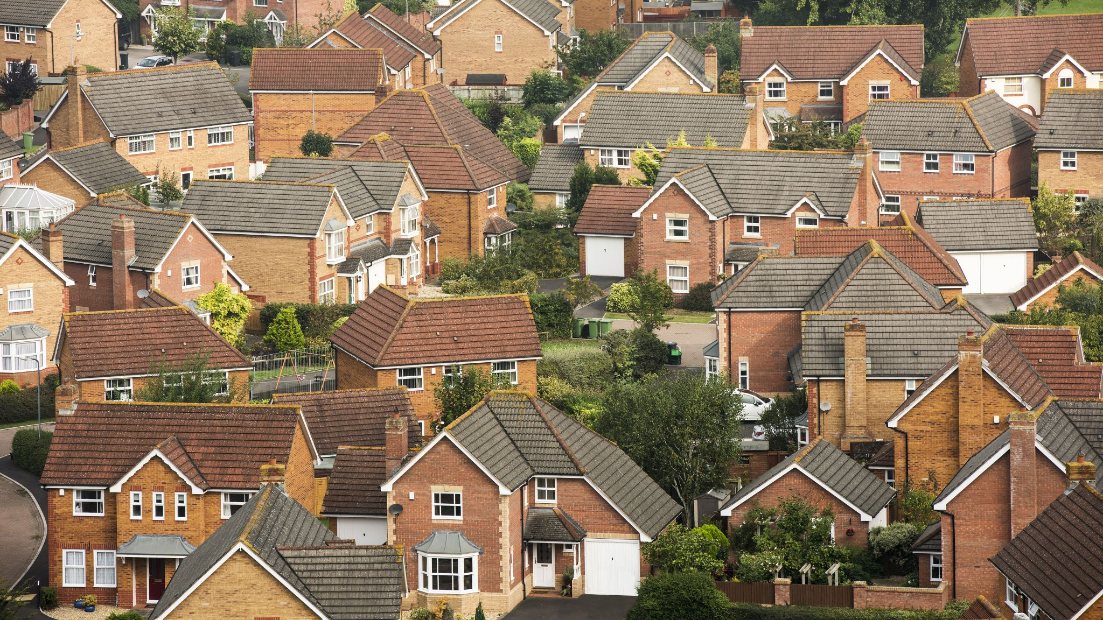
A Just Energy Transition
Requires a holistic approach that works from the ground up understanding the situation of communities
It requires moving toward a parsimonious use of energy, just enough, including greater energy use in disadvantaged communities, and the curbing of energy use by the more affluent, as well as moving toward smaller house sizes and less stuff
We need to address thermal comfort and building quality
Electrification should be first built on already developed land (e.g. urban areas) and serve community needs
Energy should be treated as a public good, and that public good cannot be achieved through the market = a new approach to utilities
And we need to develop less high tech systems to ensure affordability and simplicity

Slide 27
By way of a conclusion:
A just energy transition is by no means guaranteed
The shifts and changes that need to take place are enormous, and they can’t be predicated on adding more smart sensors and
Ground up data is critical to that transition
The transition will not be ‘economic’
The transition will need to be driven by the public interest, making energy and thermal comfort a public good.
Energy use reductions by the top 10 percent is essential – their consumption creates an energy generation burden for all
The Jobs component must be integral to the transition

