Slide 1
Vendor Setup Request Guide

Slide 2
Working with a NEW VENDOR?
This guide is NOT for vendors already in Bruin Buy

Slide 3
FIRST and MOST IMPORTANT reminder
Check with IoES team if your vendor is in the system.
If yes, proceed with placing an order.
If not, move forward with the Vendor Set Up Request.

Slide 4
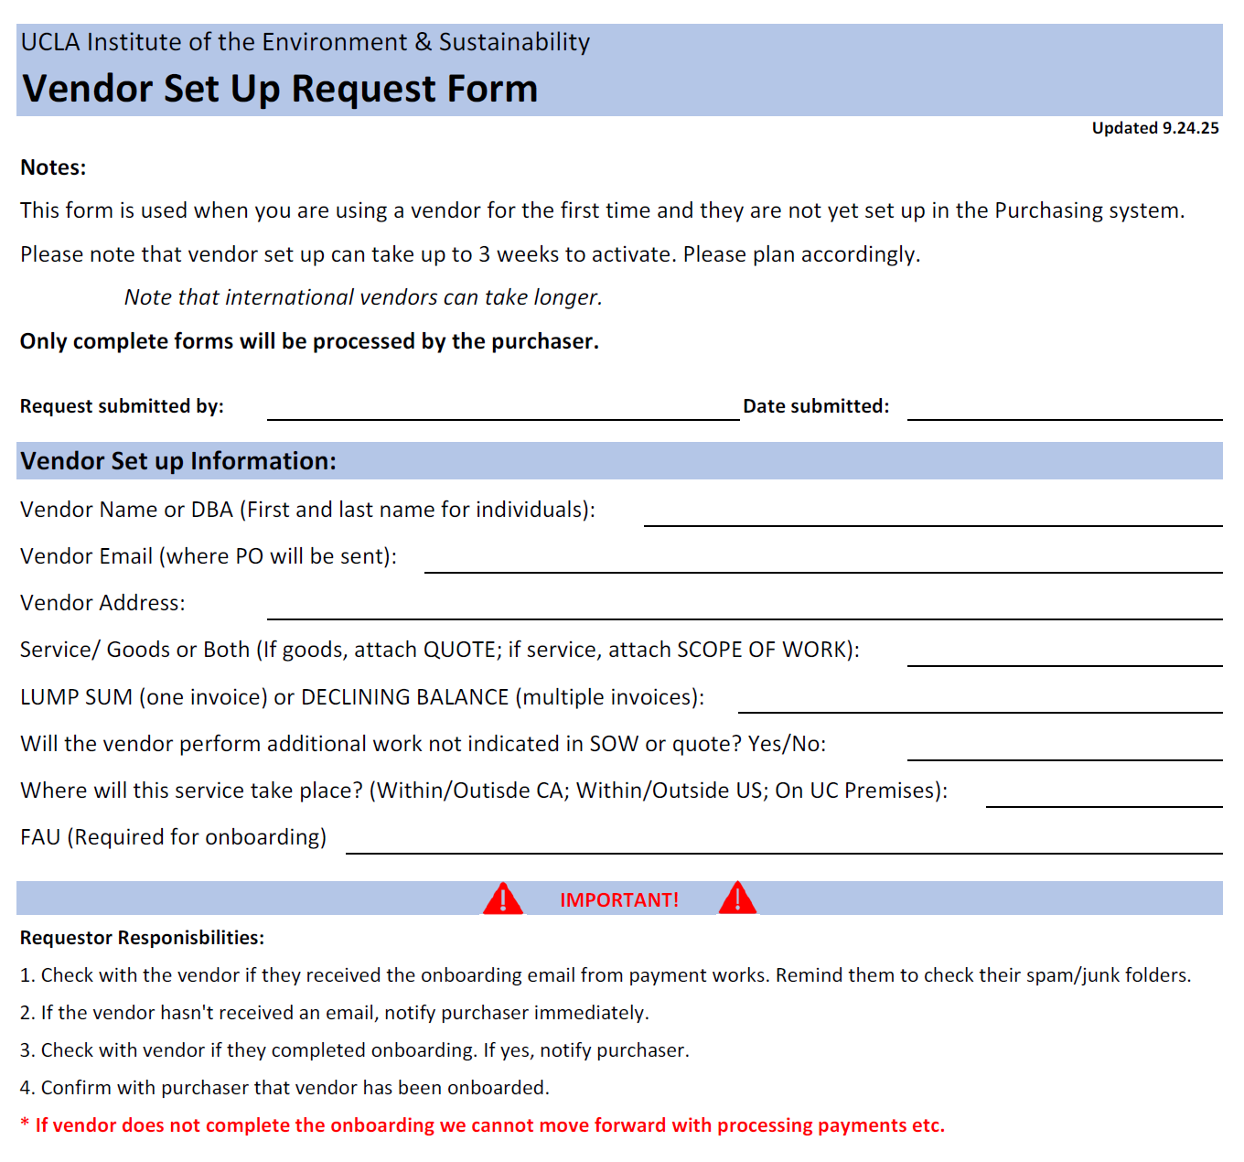
Use the correct form
We have a specific form for vendor set up requests
Please make sure you fully complete the forms
Please take note of the reminders on the form

Slide 5
Reminders
Please note that vendor setup could take 3 weeks for local vendors
International vendors can take longer
PLEASE PLAN AHEAD!

Slide 6
Information you need to submit
Vendor Name or DBA (first and last names for individuals)
Vendor email (where PO will be sent)
Vendor phone number
Identify if this request is for services or goods
    If goods, attach a quote; If service, attach scope of work
Identify if this is a lump sum or a declining balance request
  Lump sum means your vendor will send one invoice for the whole PO
  Declining balance means your vendor will send several invoices at certain intervals (weekly, monthly, quarterly)
Identify if the vendor will perform additional work outside of SOW
Identify location of service

Slide 7
Requestor Responsibilities
Check with the vendor if they received the onboarding email. Remind them to check junk/spam folders.
If the vendor did not receive email, notify purchaser immediately
Check with vendor if they completed onboarding.
Notify purchaser when vendor has completed onboarding.
Check with purchaser if your vendor has been onboarded.

Slide 8
If vendor does not complete the onboarding, we cannot move forward with anything at all.

Slide 9
Do NOT submit a purchasing/payment/contract request for a vendor that has not been onboarded.

Slide 10
Submit requests to: purchasing@ioes.ucla.edu

